Slide 1
YOU’RE WELCOME TO VISIT OUR BOOK FAIR IN THE LIBRARY
6:00pm to 8:00pm.
SEE YOU THERE!
Chance to Win a Raffle!

Slide 2
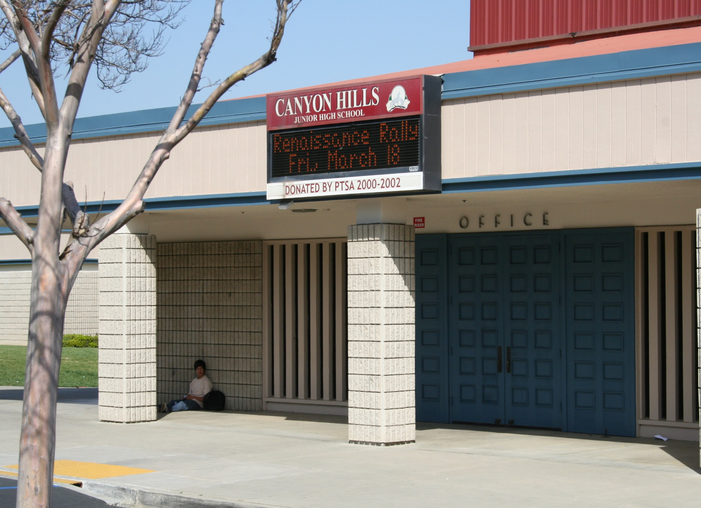
Welcome to Canyon Hills Junior High School
New Student Orientation
2015-16

Slide 3
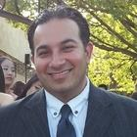
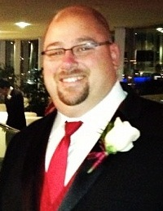
Administration
Mr. Shehzad Bhojani
Principal
Assistant Principals
Ms. Renee Edwards (7th Grade)
Mr. Daniel Gervais (8th Grade)

Slide 4
Office Staff

Slide 5
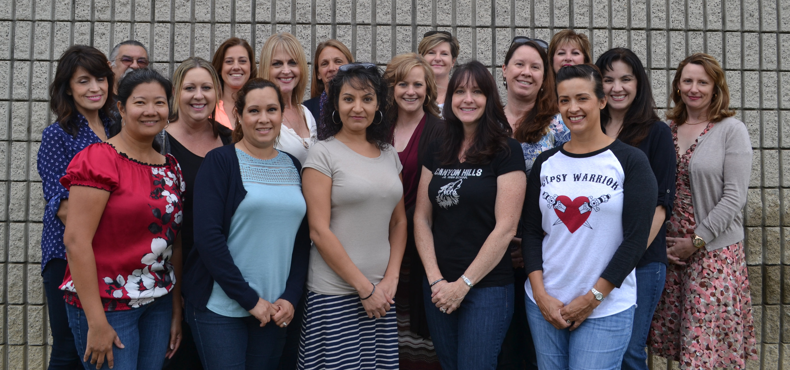
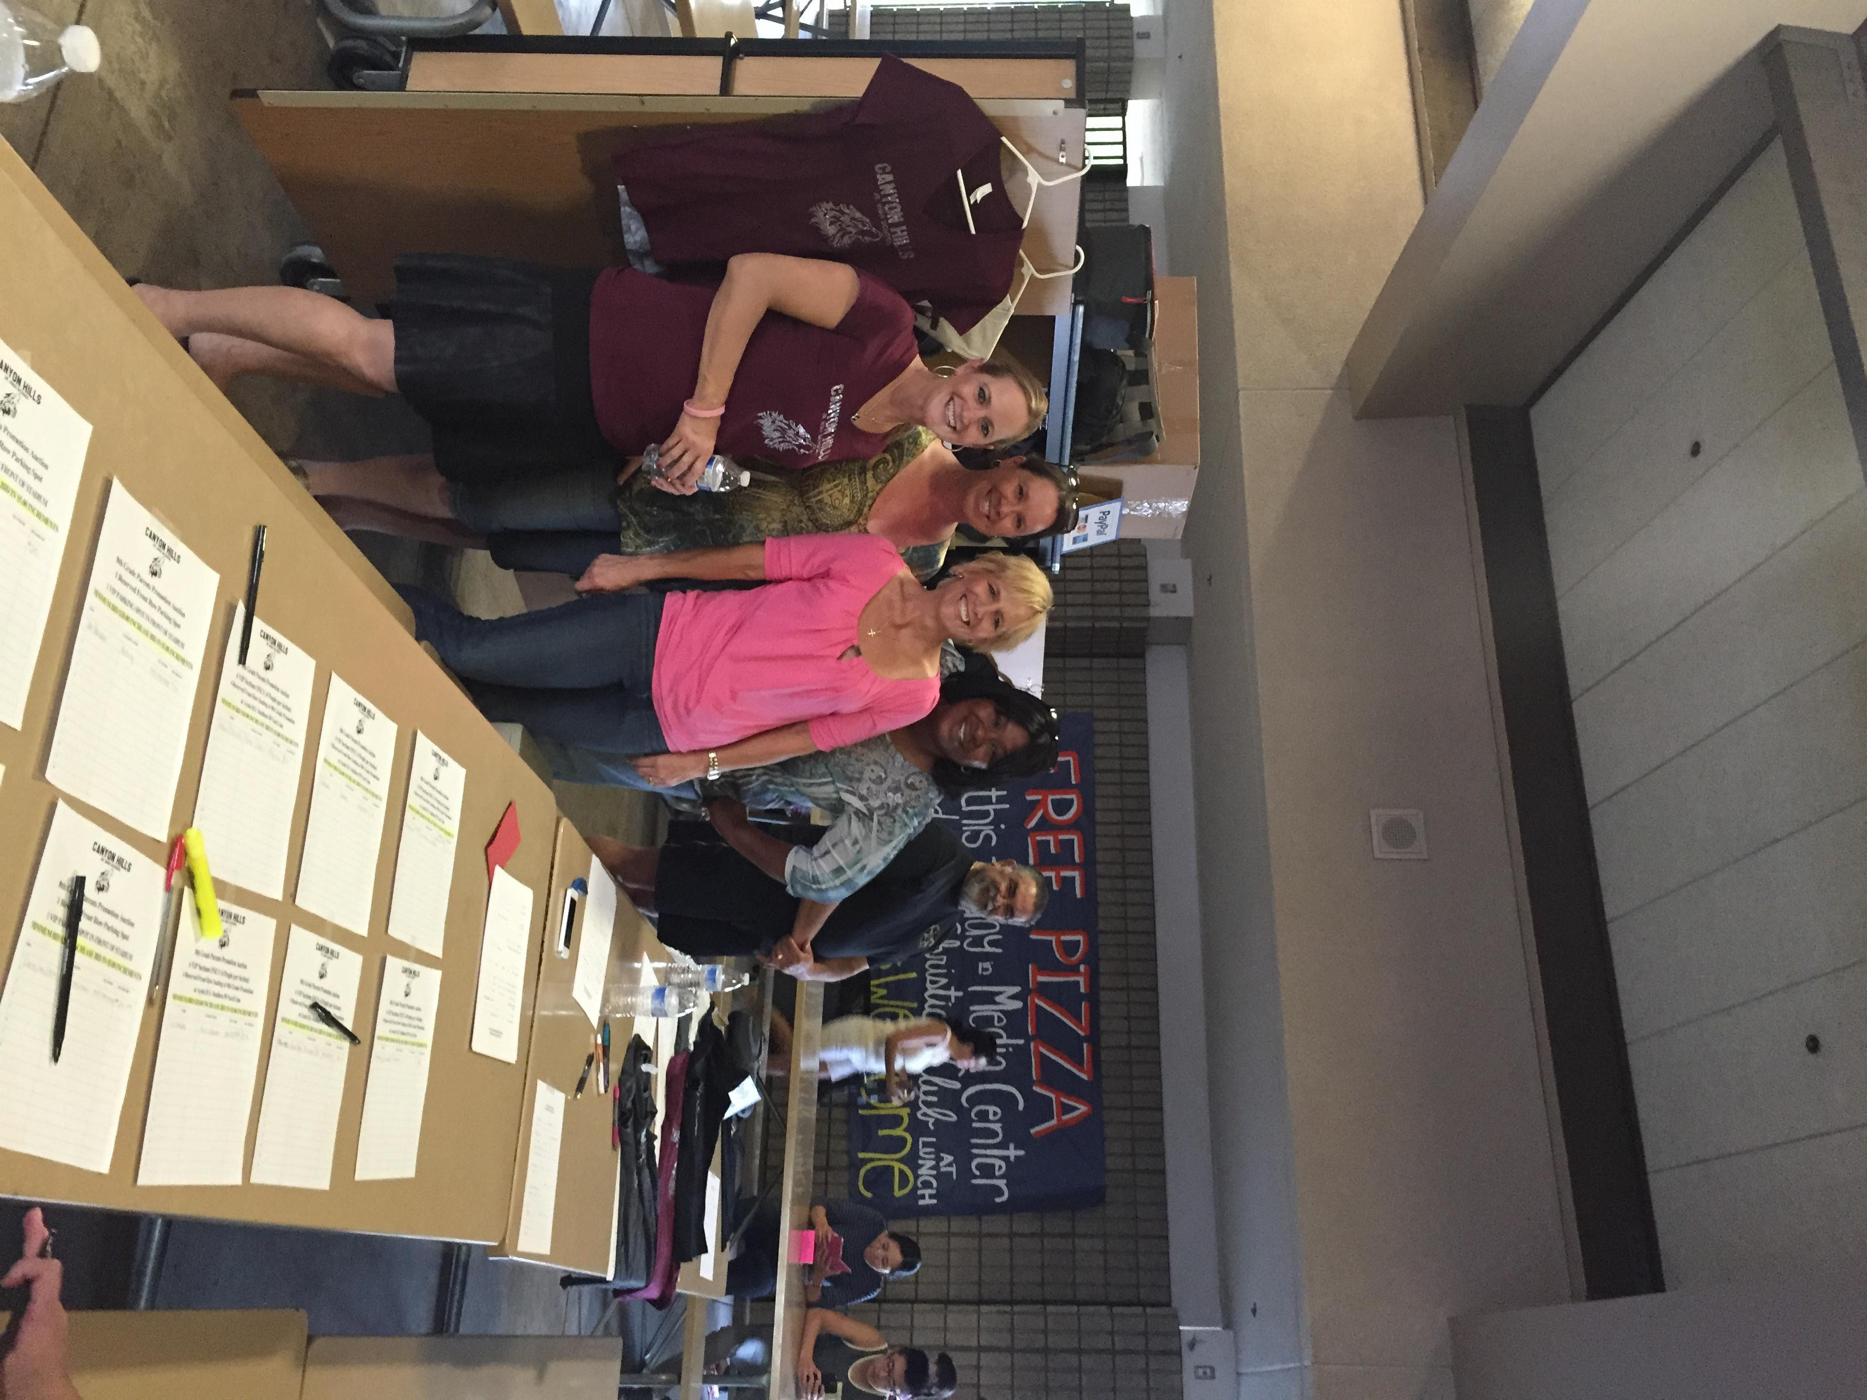
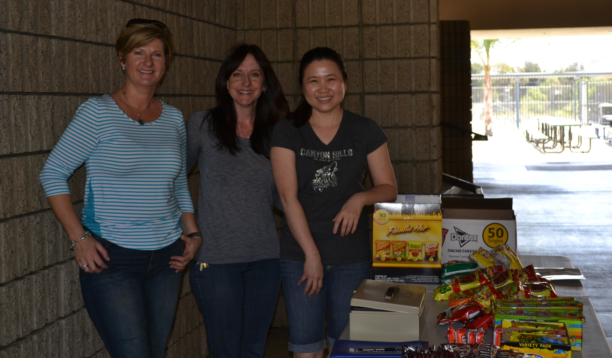
PTSA

Slide 6
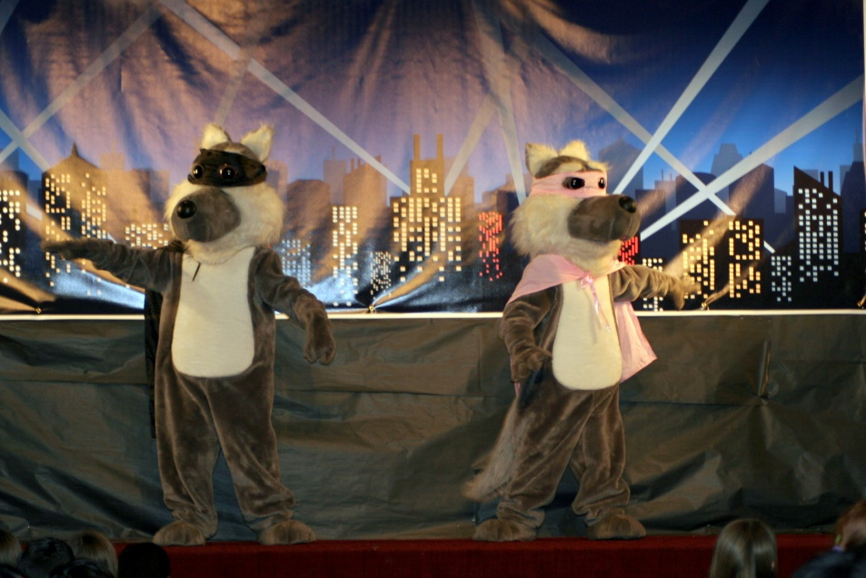
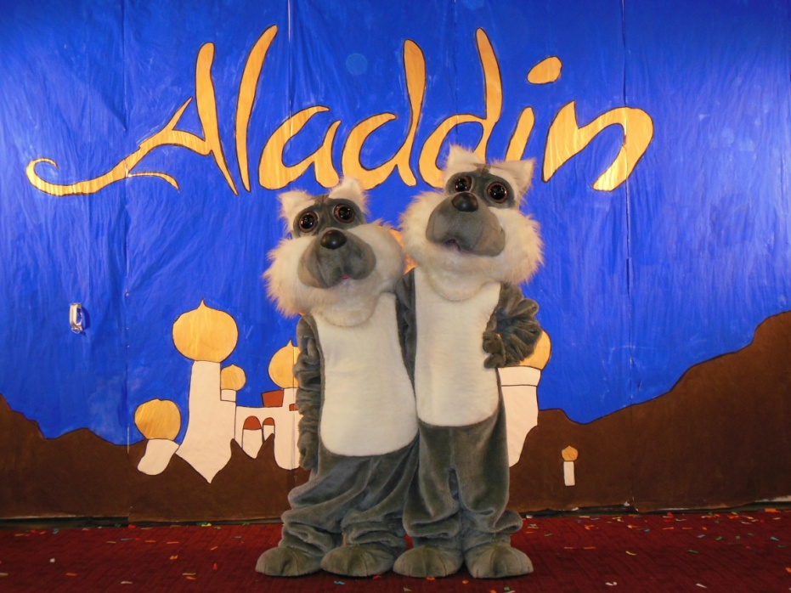
Coyote Mascots are
Howler and Echo
Our school colors are Maroon and Gray (Don’t forget to purchase your Spirit Wear)

Slide 7
Focus on the WHOLE CHILD
Preparing Kids for a Rapidly Changing Global Economy
Academic Skills
Social Skills
Emotional Skills

Slide 8
Academic Skills
21st Century Skills
Career & College Readiness
Common Core State Standards
More depth versus breadth
Literacy Standards, Math Standards, Next Gen. Sci. Standards
Focus on Critical Thinking, Creativity, Communication, Collaboration

Slide 9
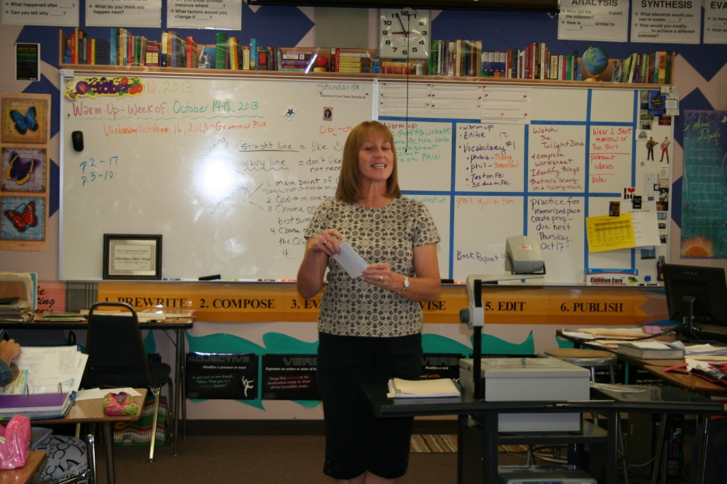
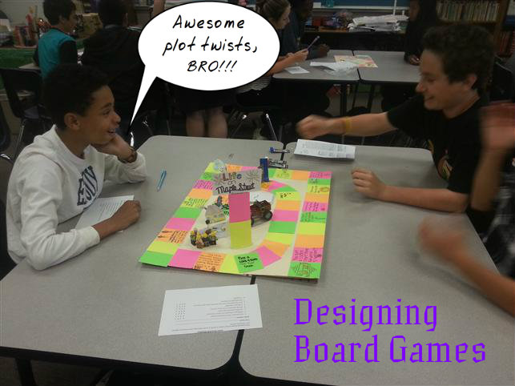
Language Arts
Building knowledge through content-rich informational (fiction & non-fiction) texts
Read, write and speak grounded in evidence
Regular practice with complex text and its academic vocabulary
Literacy Across the Curricular Areas
Notes:
We require students to have a novel with them each day!

Slide 10
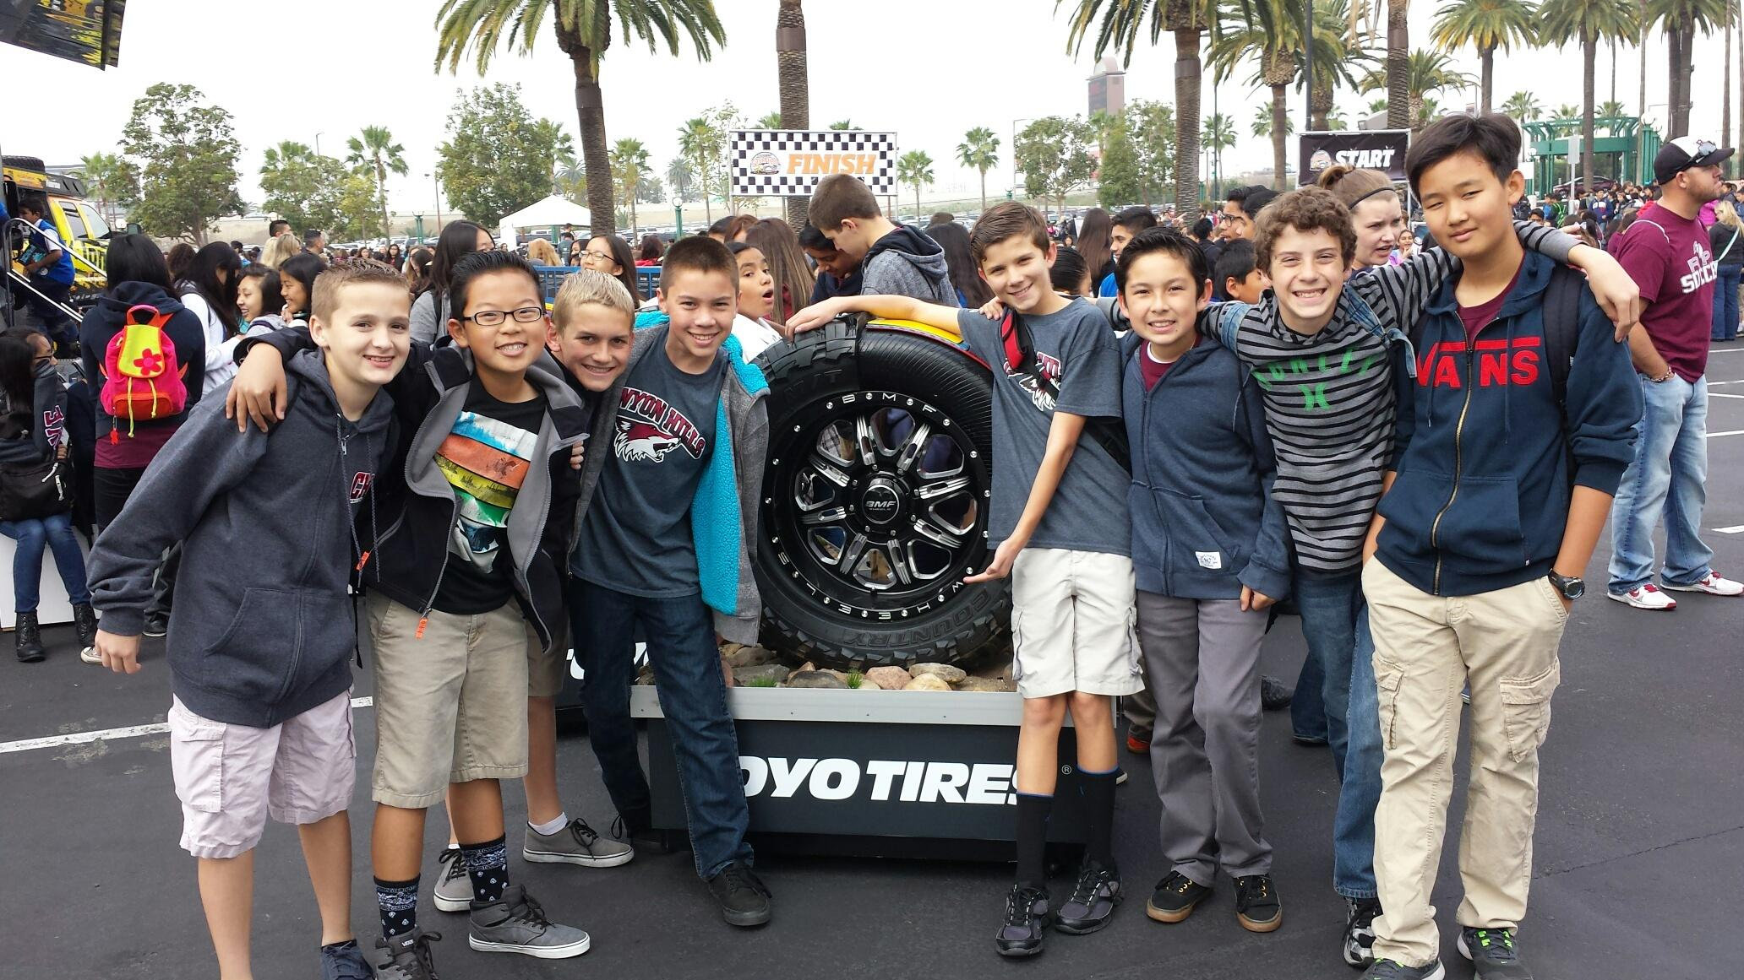
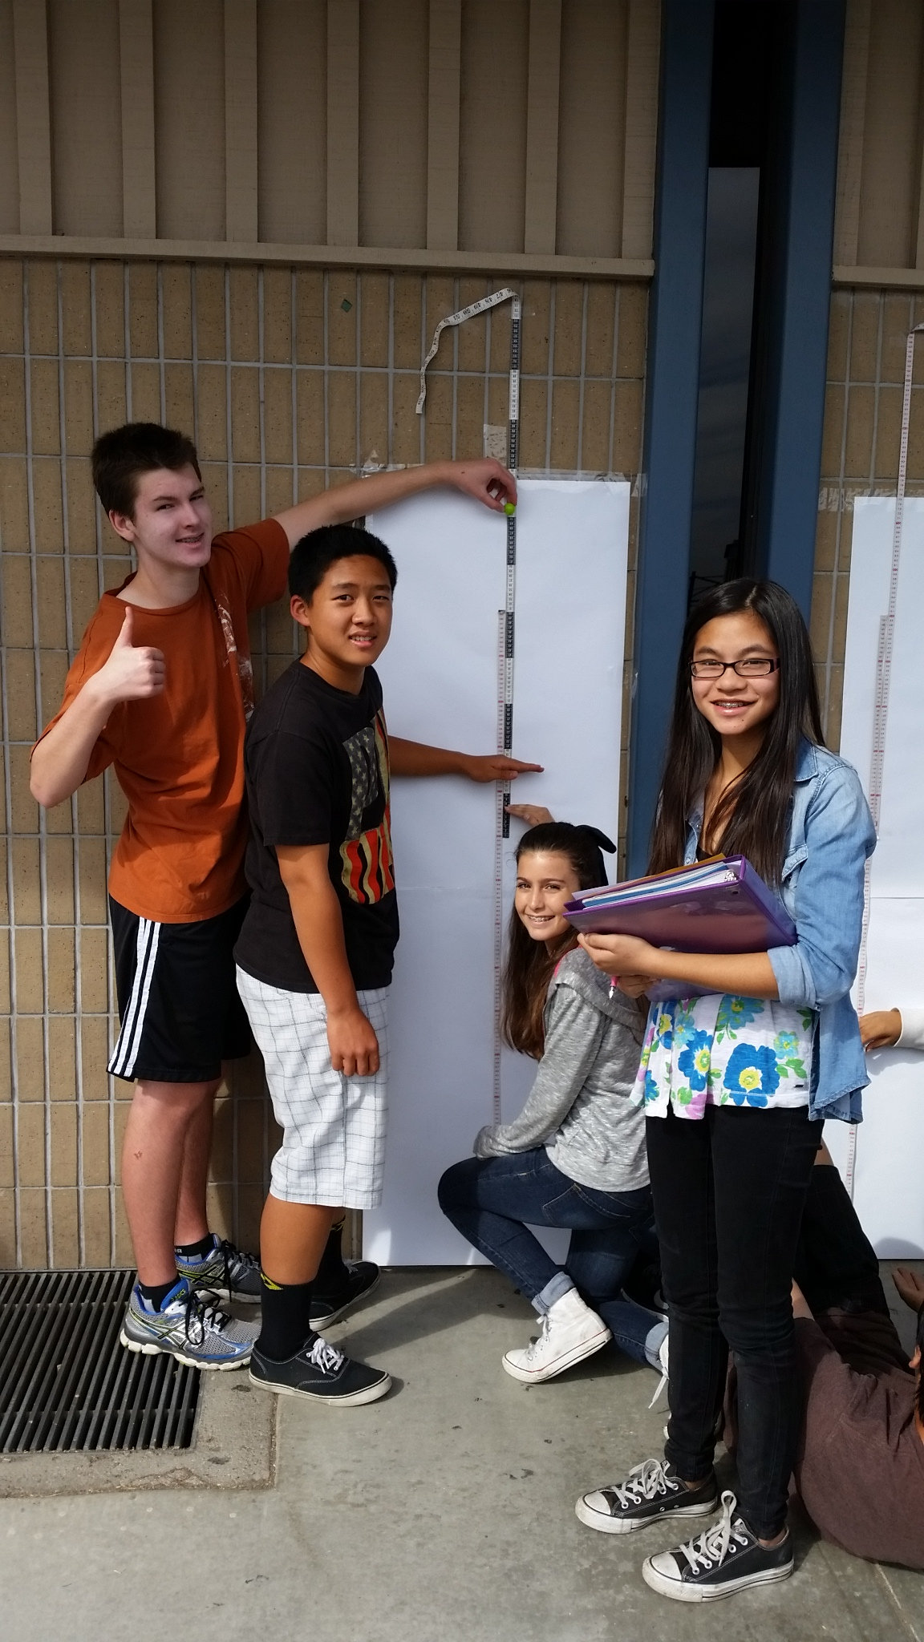
Math
Building knowledge through content-rich informational (fiction & non-fiction) texts
Read, write and speak grounded in evidence
Regular practice with complex text and its academic vocabulary

Slide 11
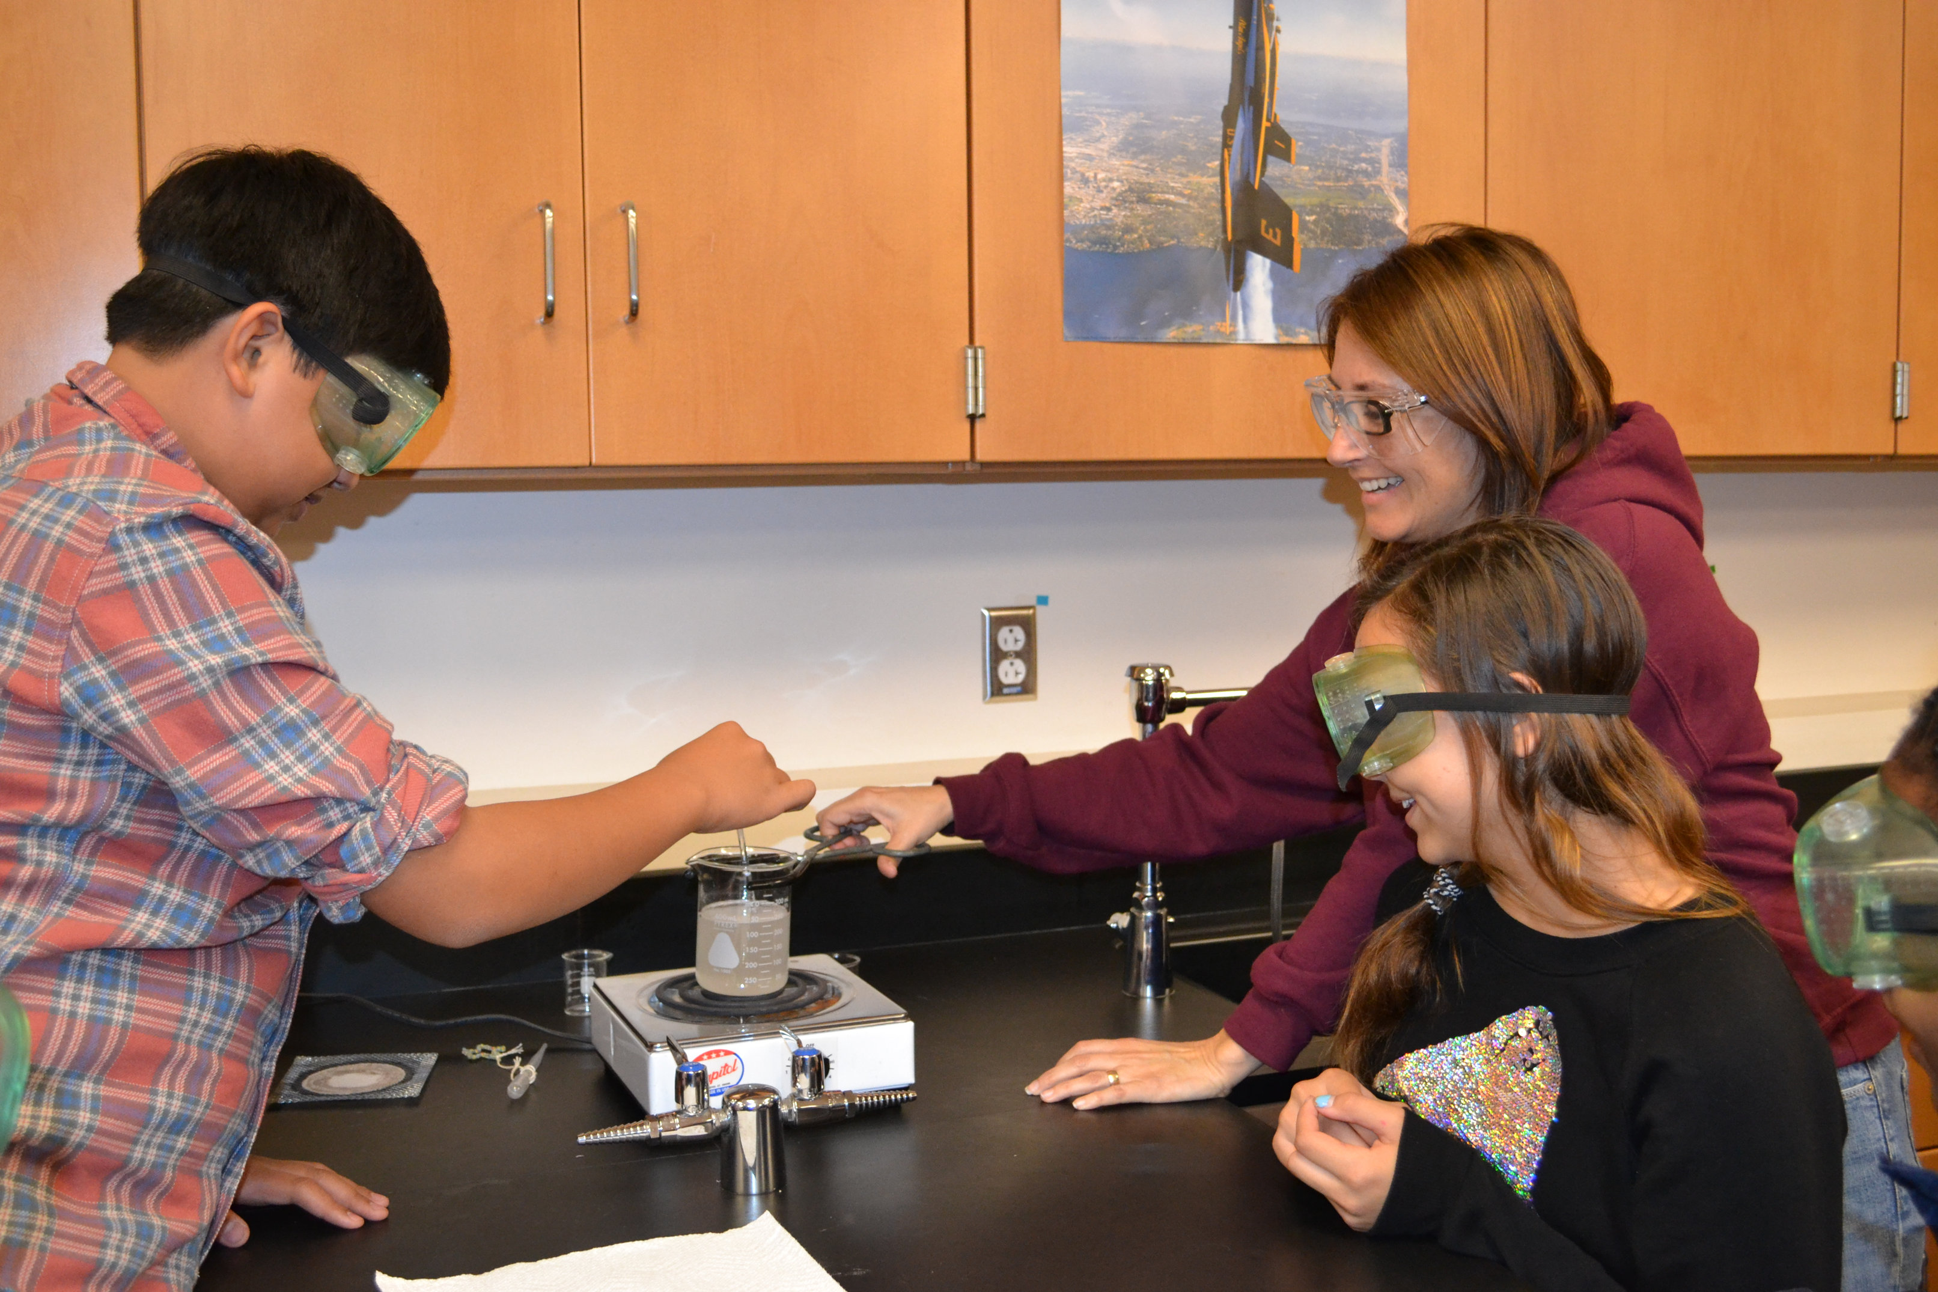
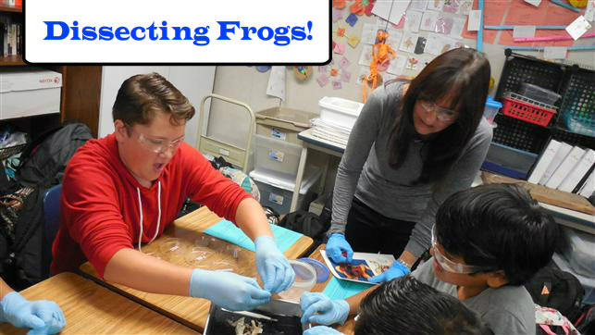
Science
Building knowledge through content-rich informational (fiction & non-fiction) texts
Read, write and speak grounded in evidence
Regular practice with complex text and its academic vocabulary
Next Generation Science Standards (NGSS)
STEM - focus on Science, Technology, Engineering & Math

Slide 12
History
Supporting Literacy
Citing evidence from reading, viewing and hearing primary sources such as speeches, court appearances, documents (Constitution) treaties, photographs, affidavits etc.

Slide 13
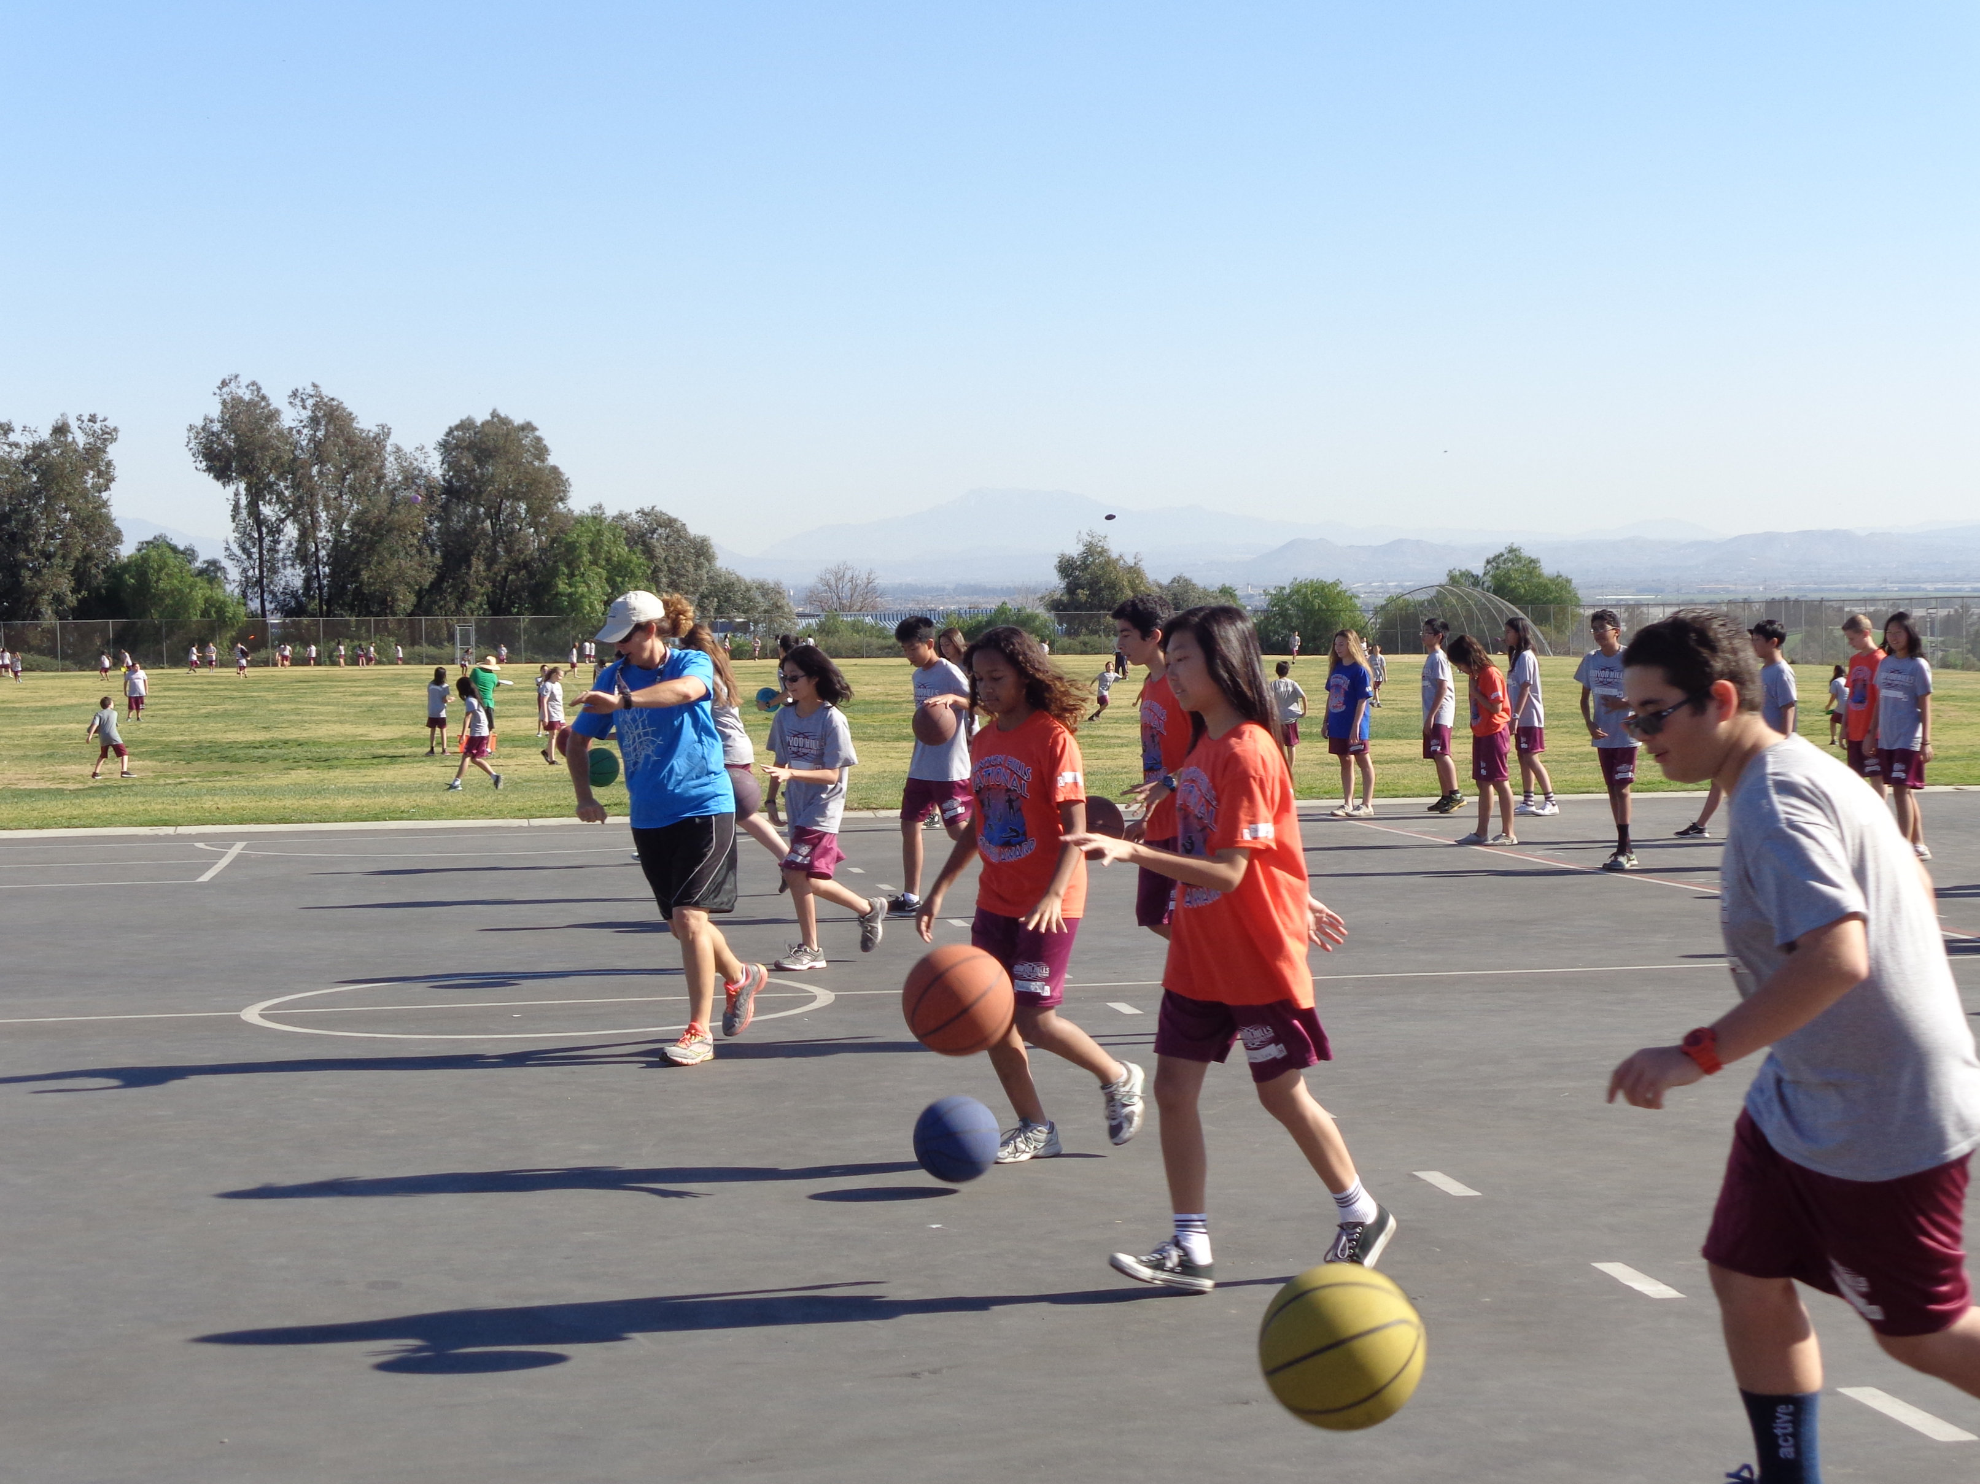
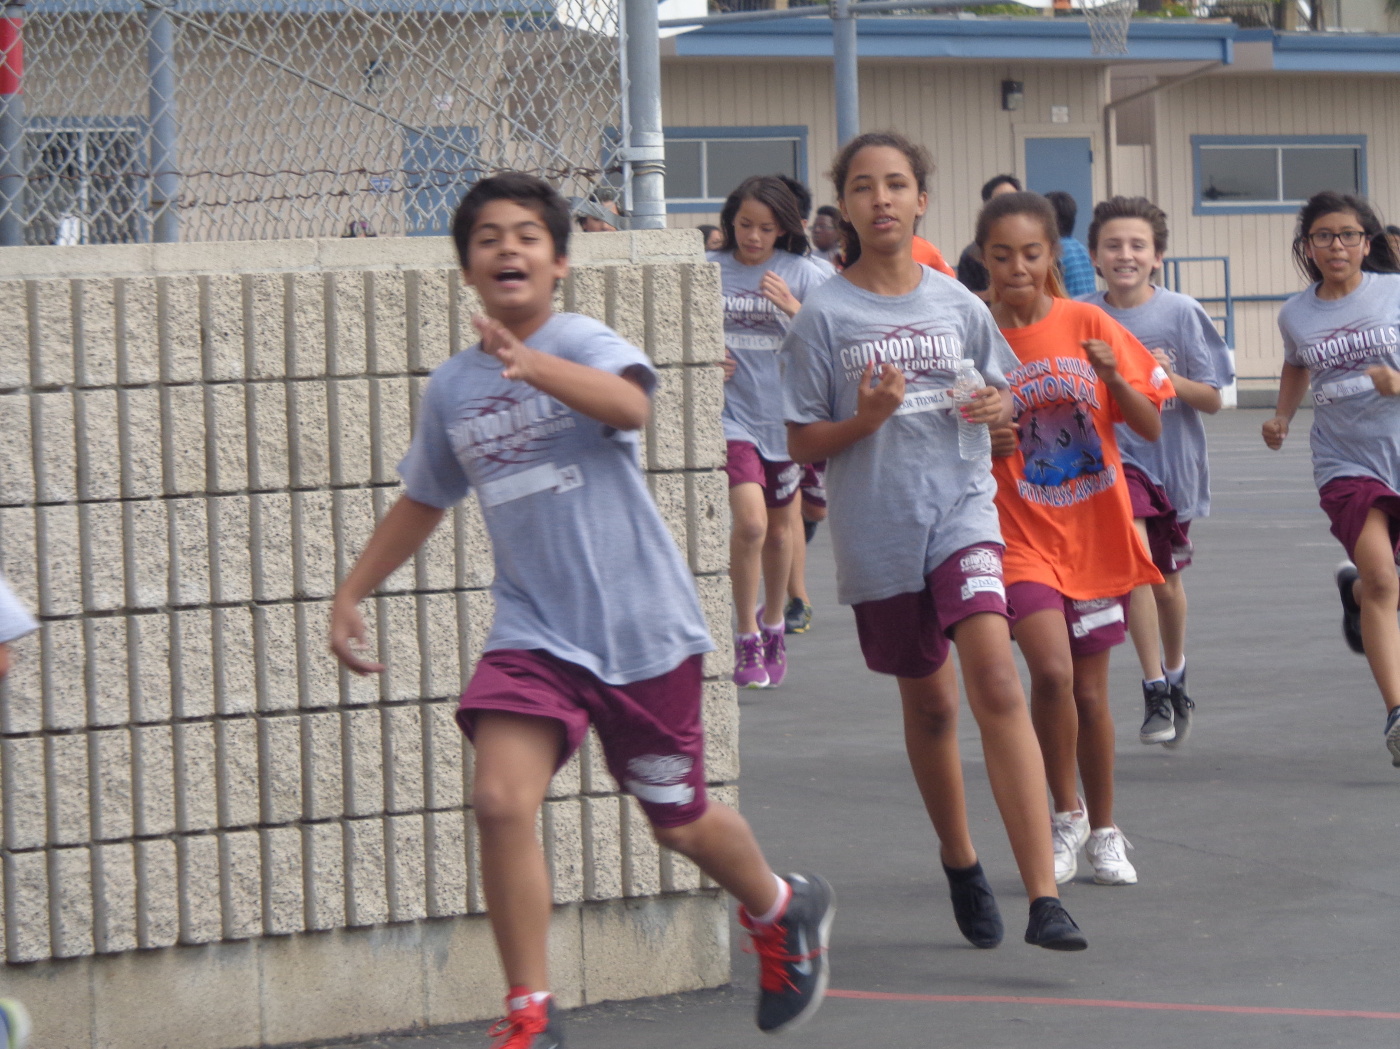
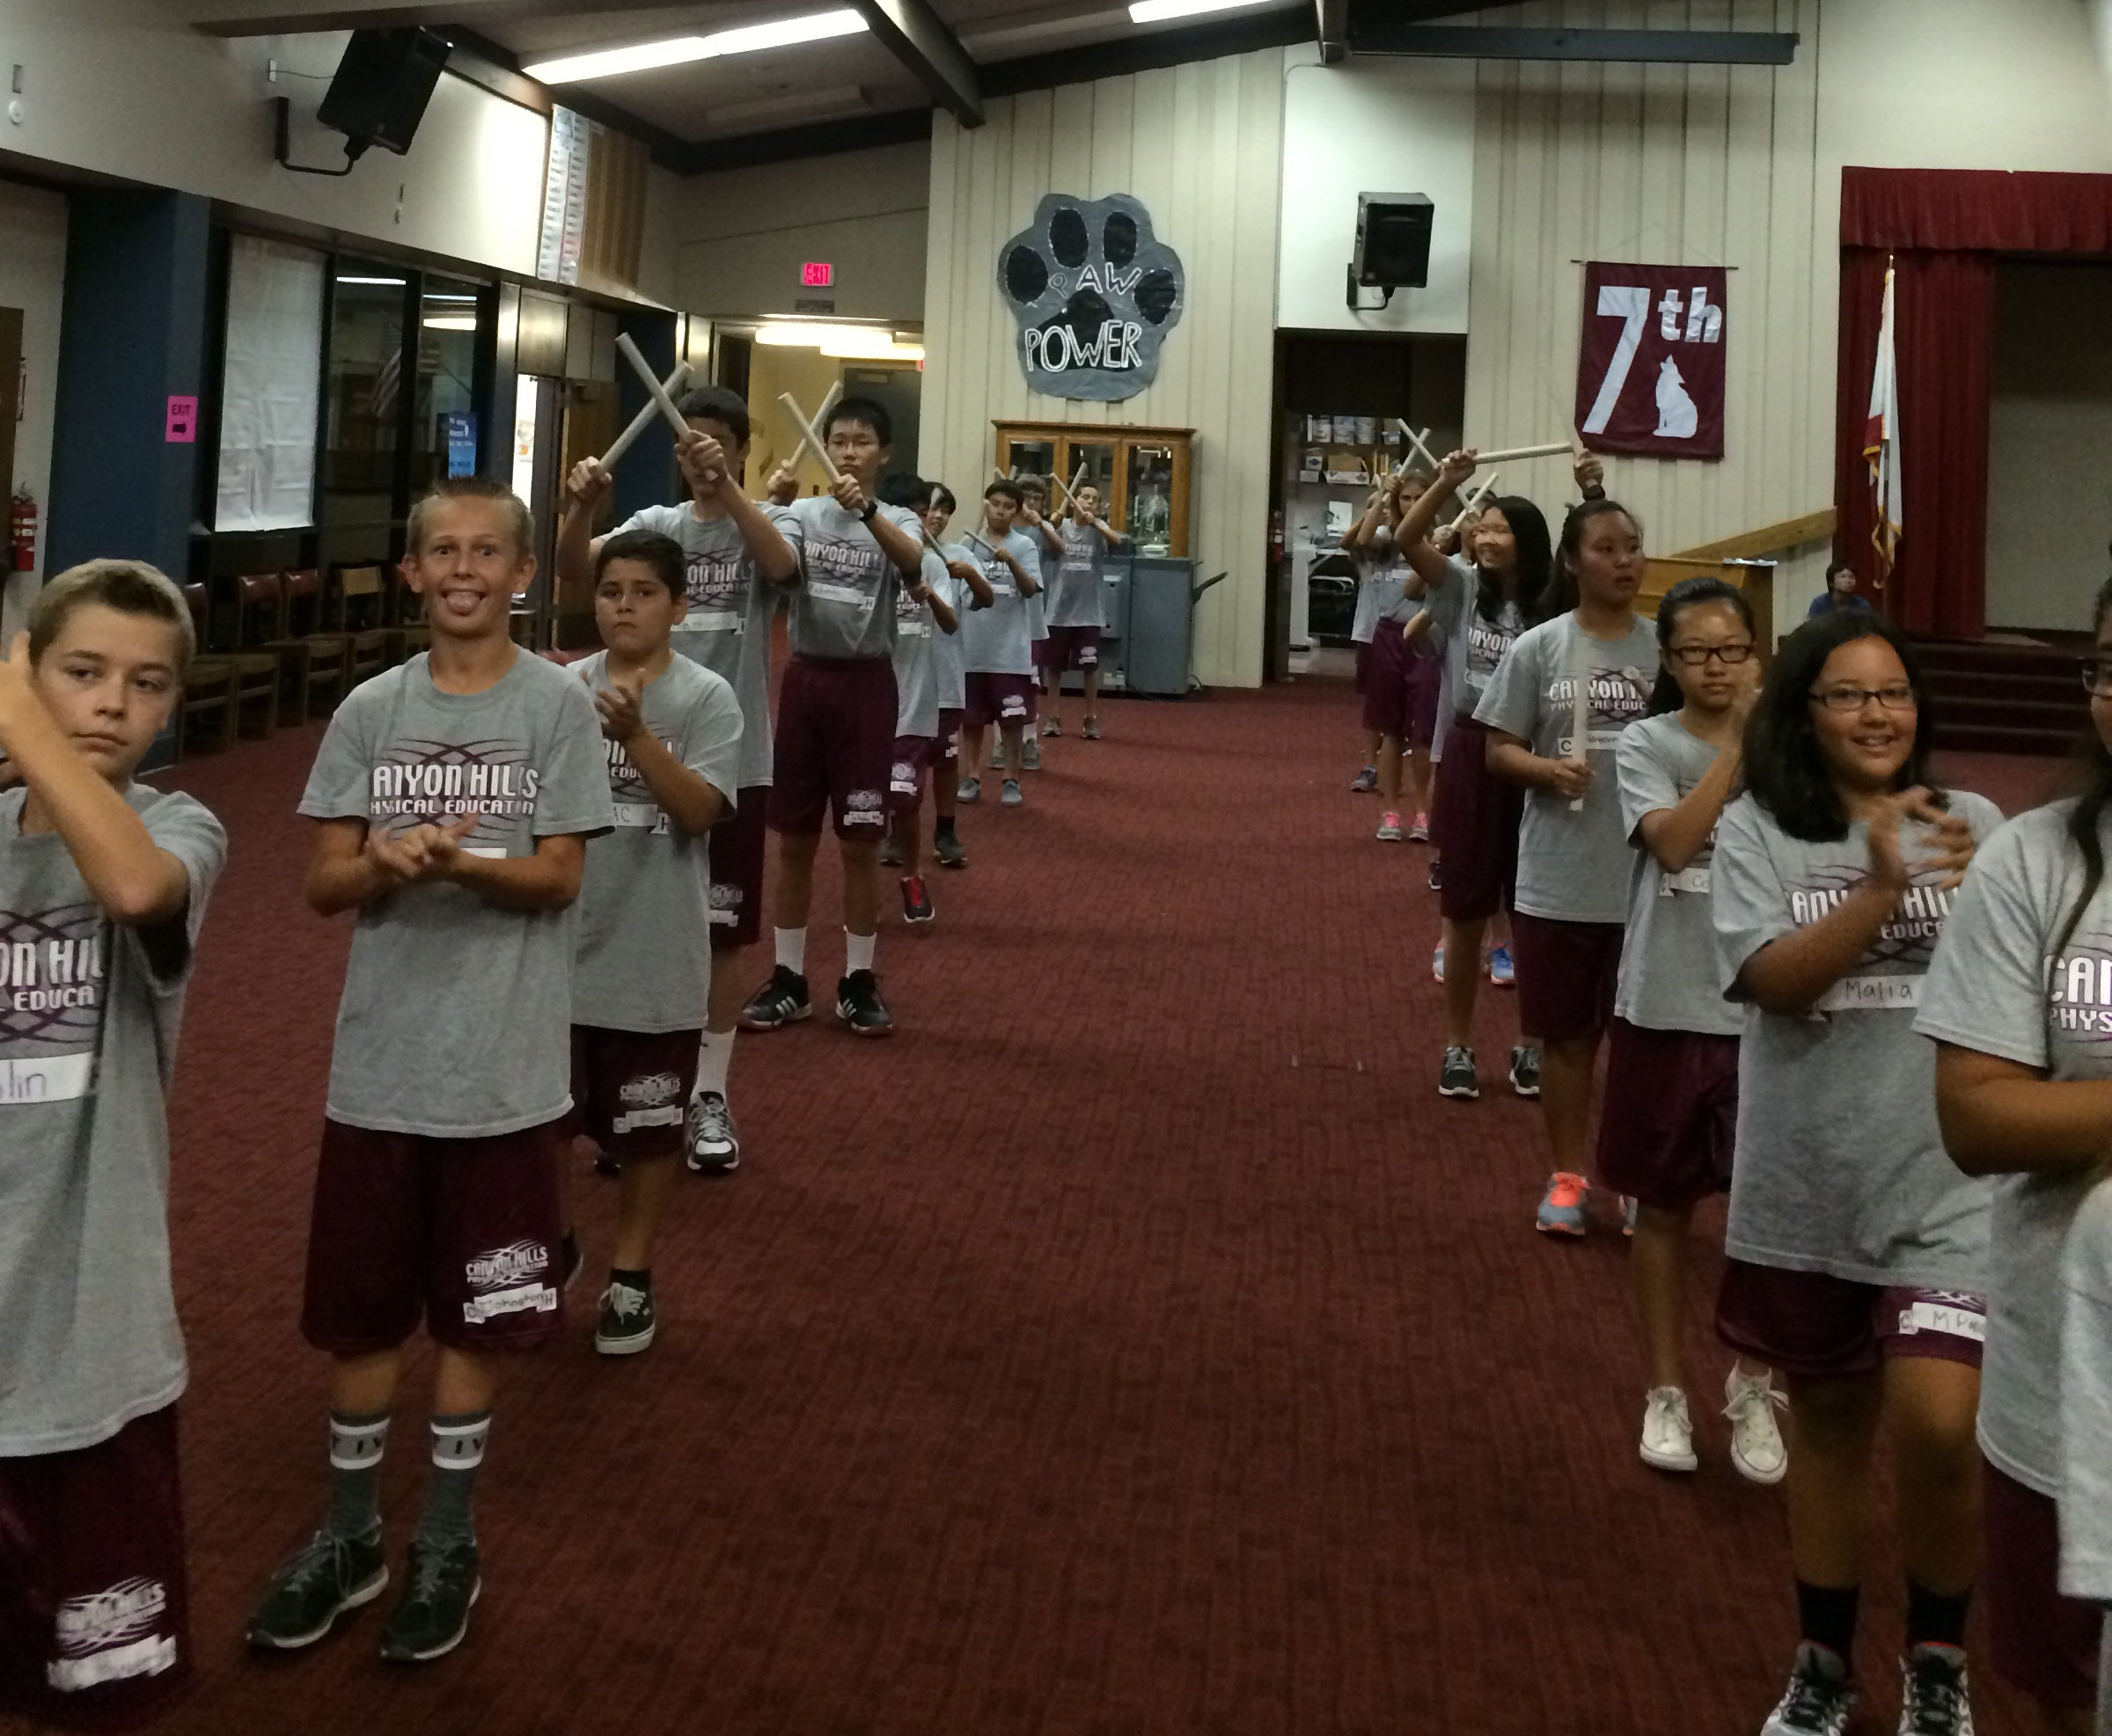
P.E.
Notes:
Make-up after school run days
Running shoes
Be ready & sitting on your #s
No showers, but please send deodorant
Take home clothes on the weekend
Fit for learning
Eat a breakfast or send a snack– best for learning
Medication or doctors notes – through the office

Slide 14
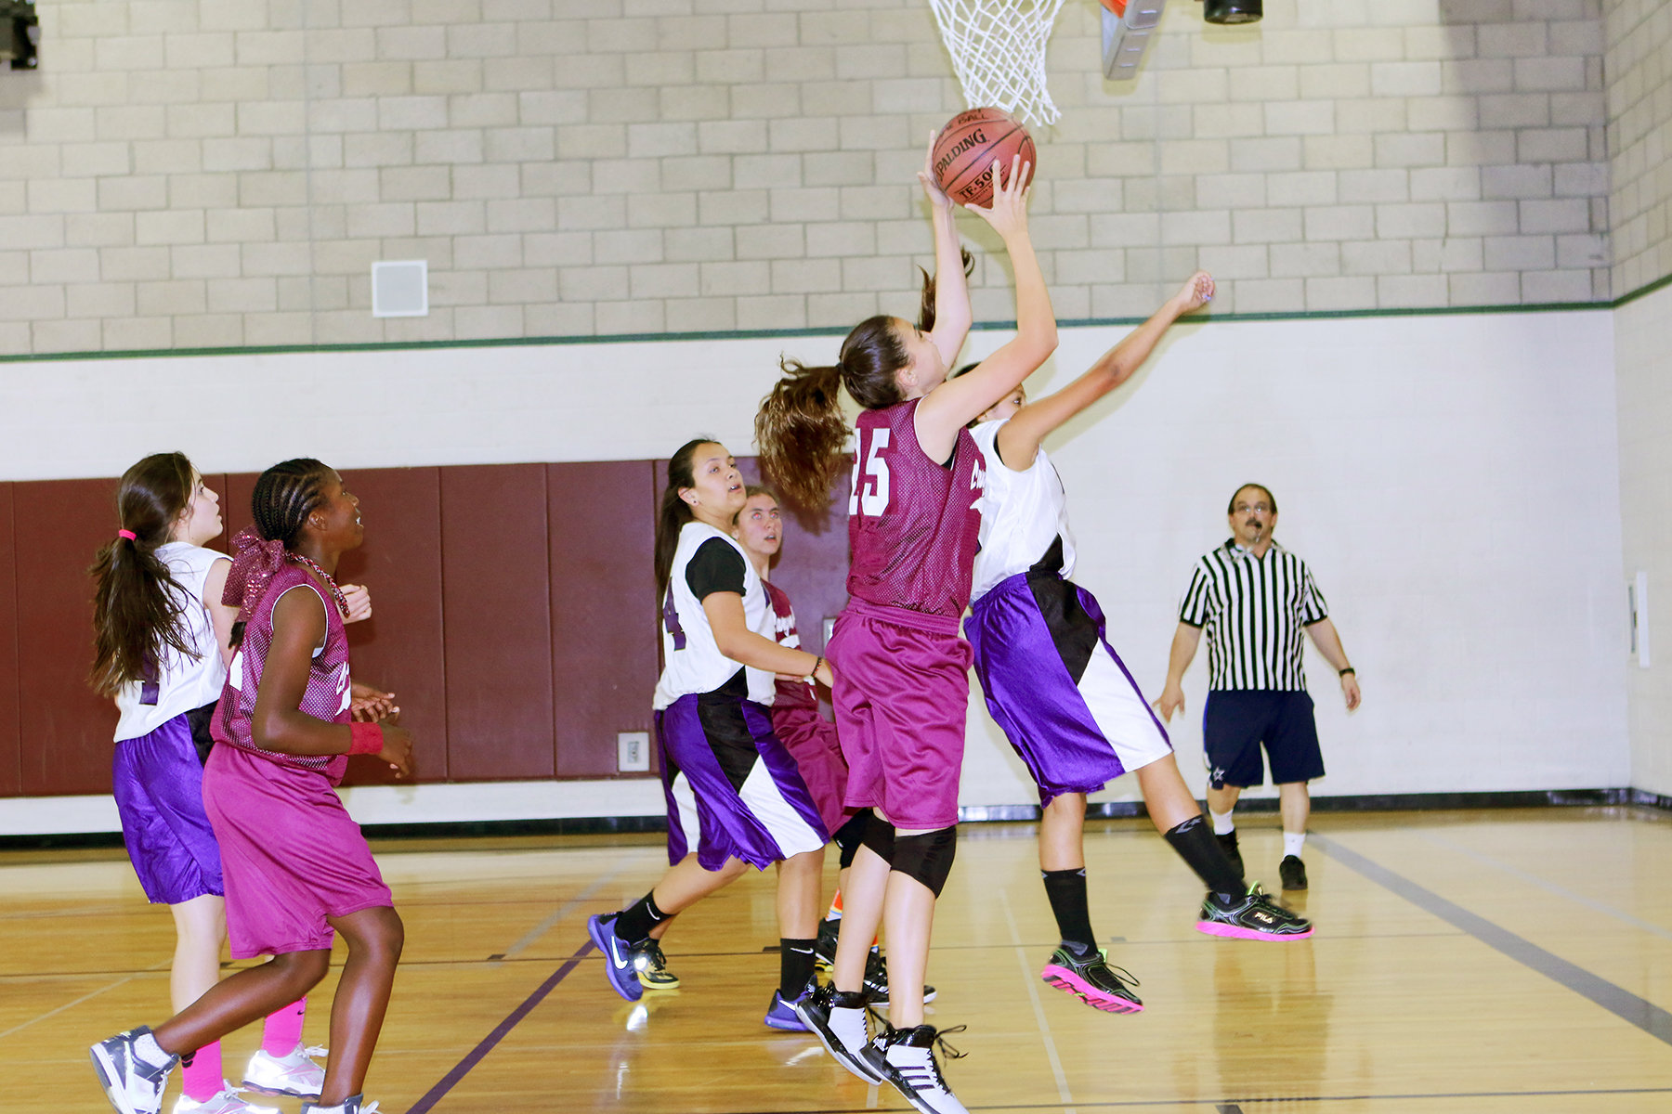
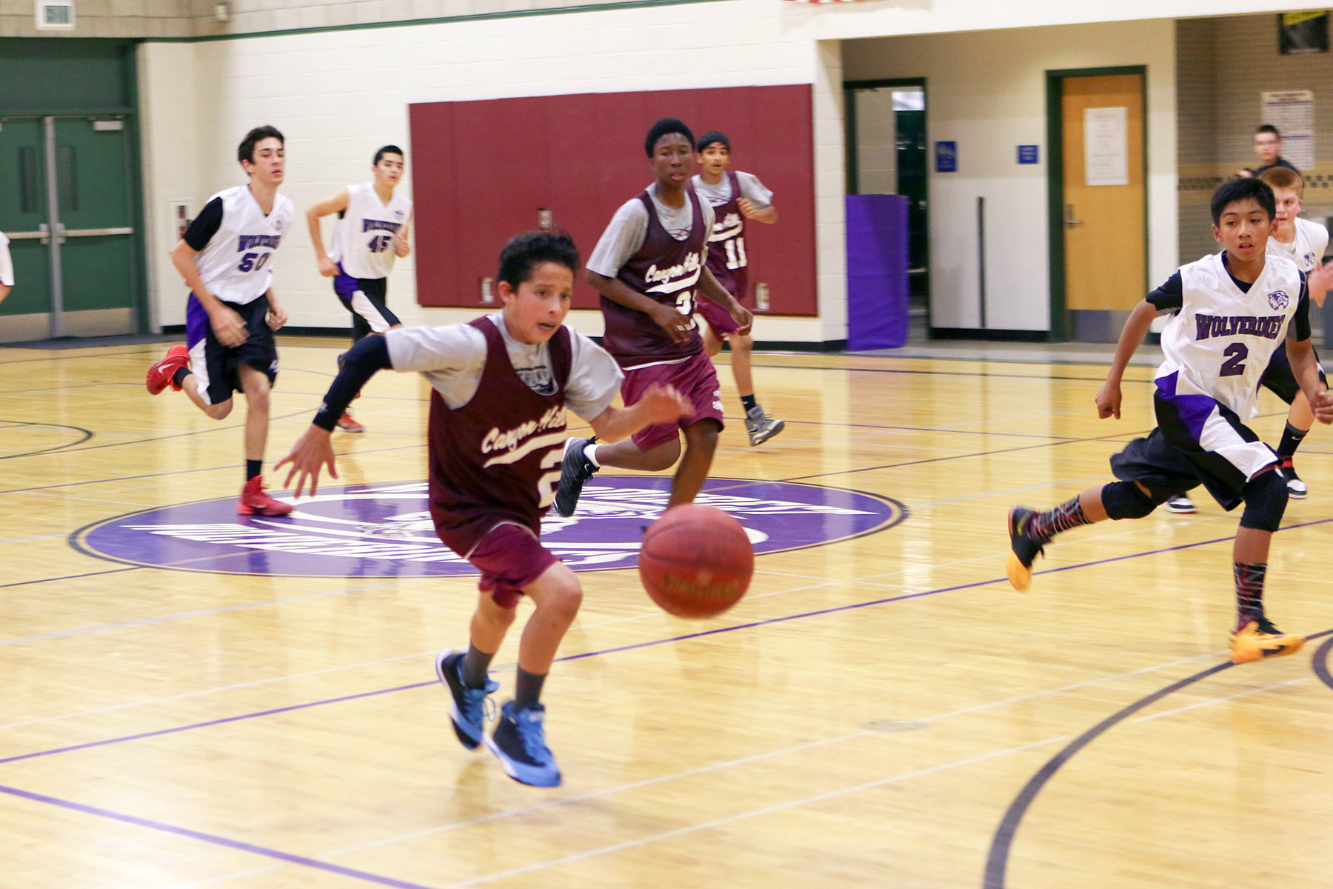
Boys & Girls Basketball Teams

Slide 15
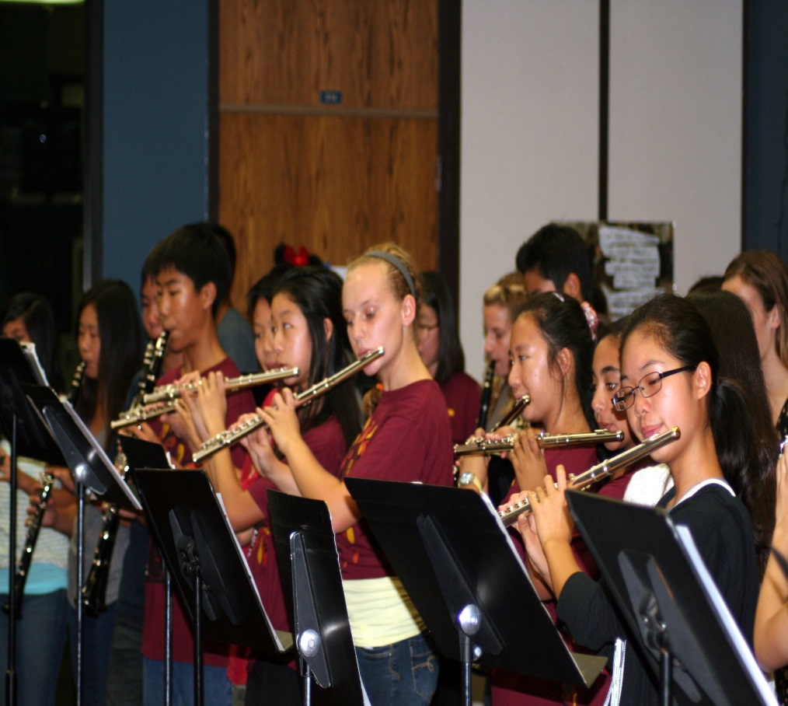
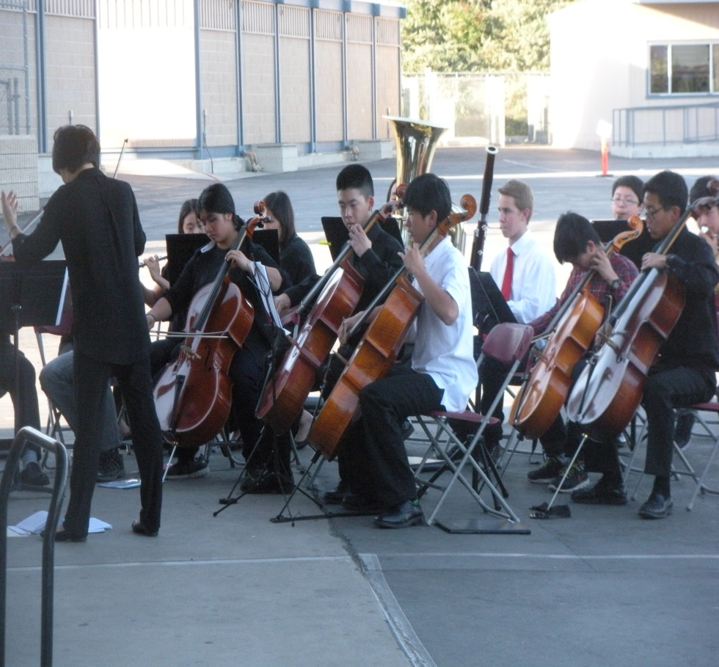
Electives
Band
Orchestra

Slide 16
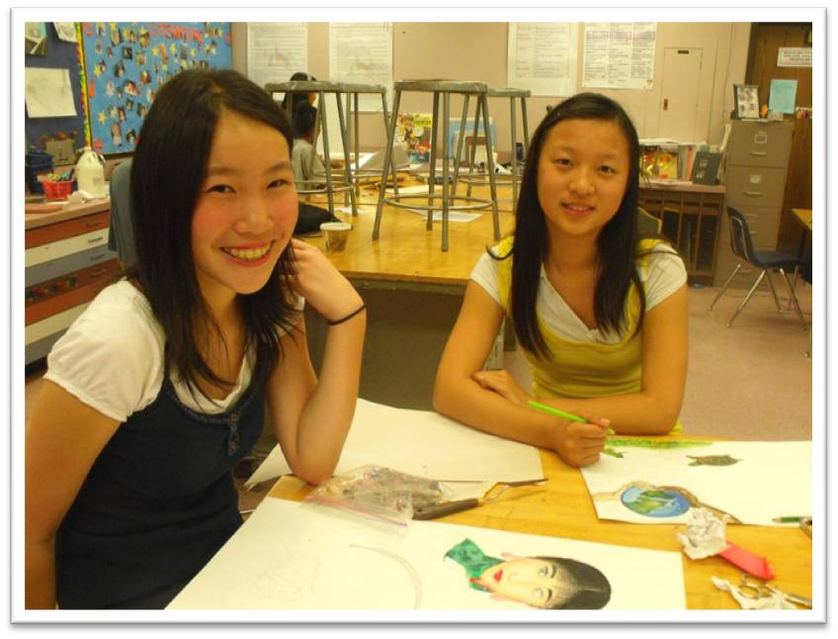
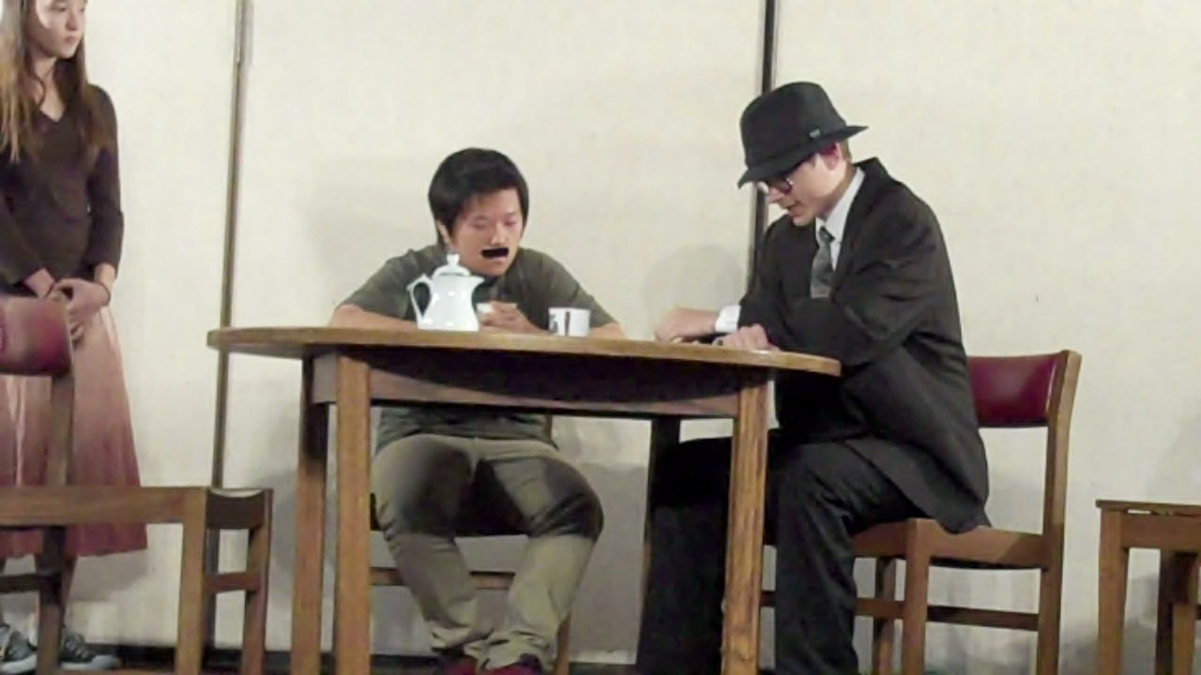
Electives
Art
Drama
Life Skills

Slide 17
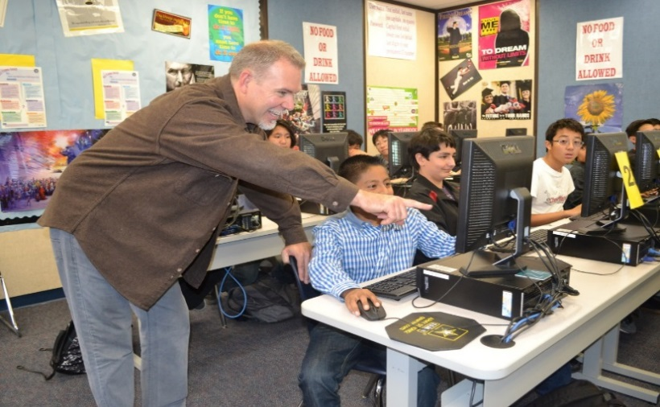
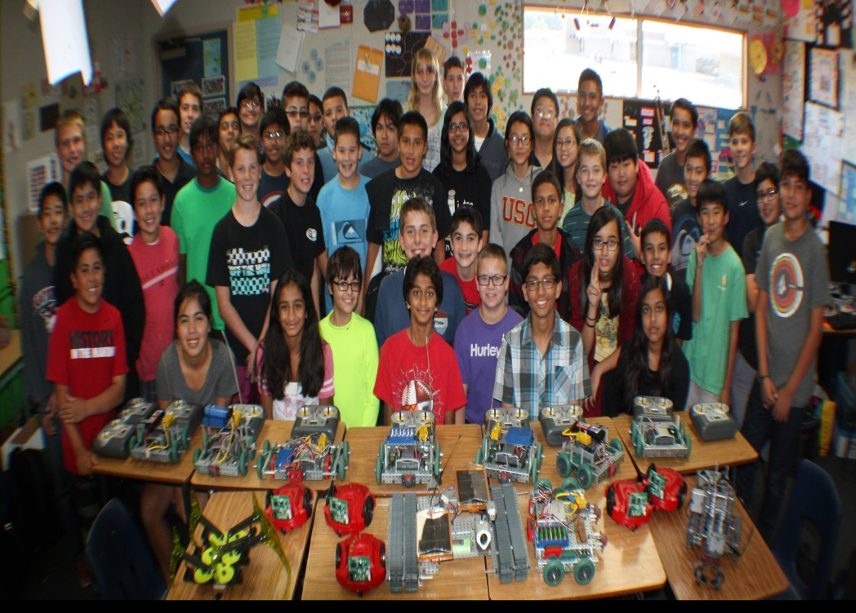
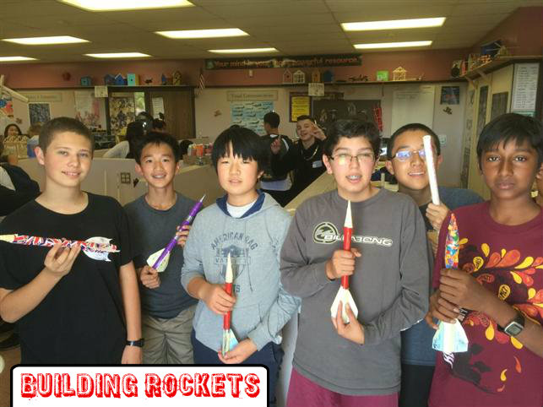
Electives
Computers &
Technology
Robotics

Slide 18
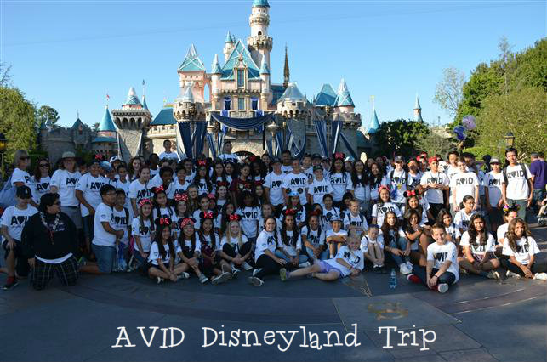
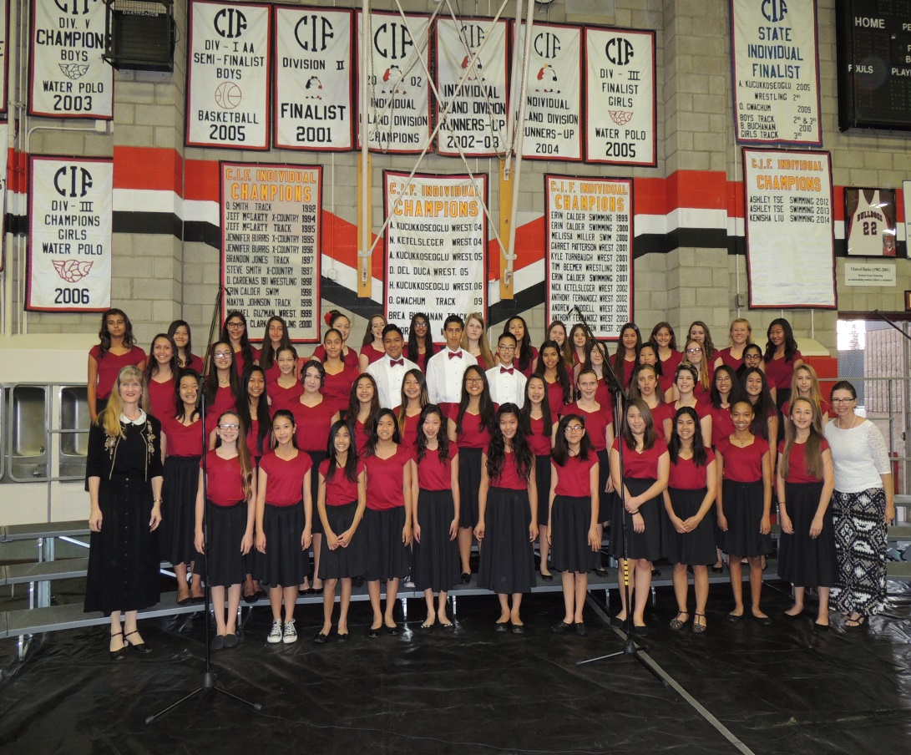
Electives
AVID
Choir

Slide 19
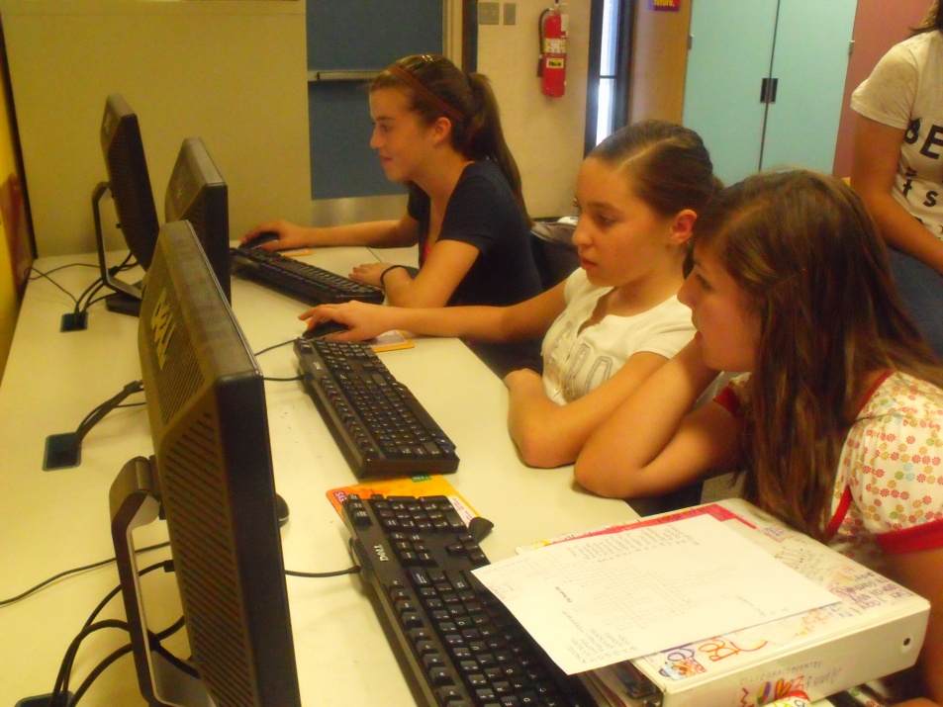
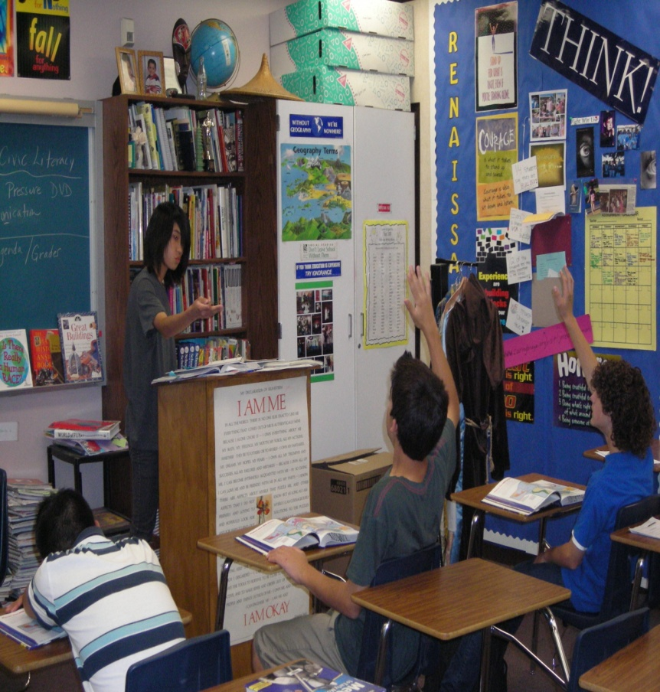
Electives
Yearbook
Civic Literacy

Slide 20
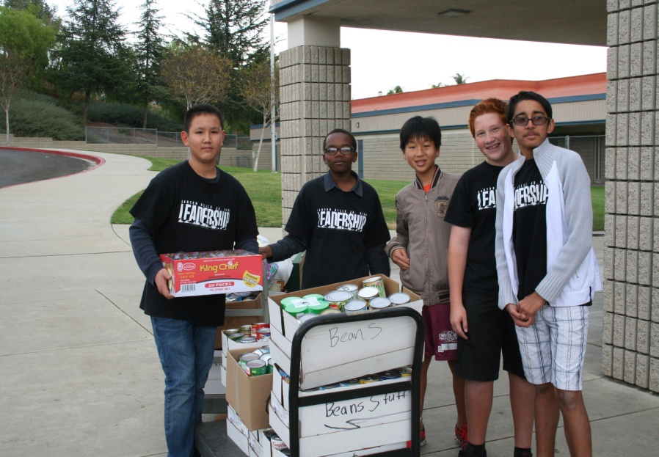
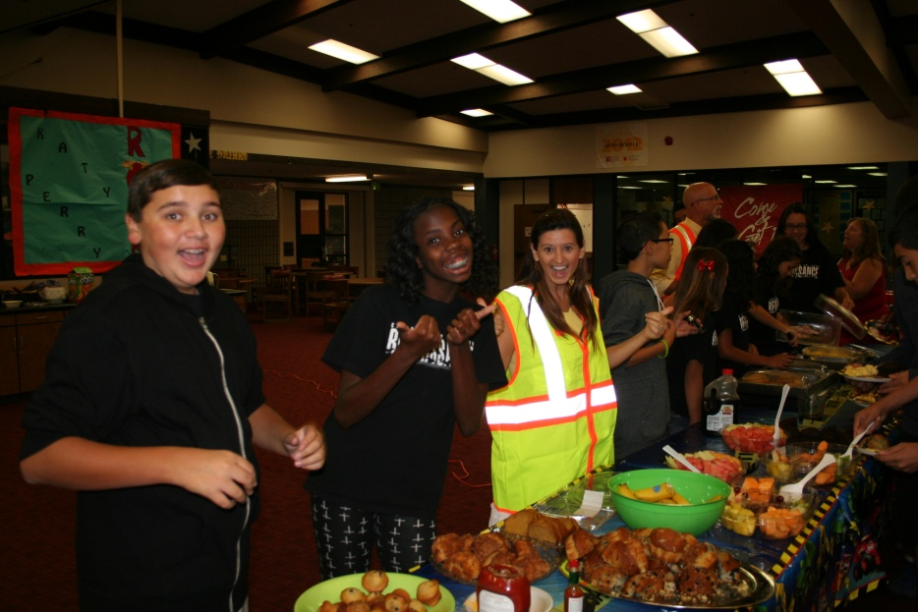
Electives
Leadership
Renaissance

Slide 21
Mrs. Uhr, Counselor
Mission Statement: The mission of Canyon Hills Junior High School’s counseling program is to provide a comprehensive, developmental program that addresses the academic, career, personal and social development of all students.
Academic and Personal Counseling
Career and College Readiness
Academic skills support
Organization, study and test taking skills, goal setting
Collaboration with students, parents and teachers to ensure student success
Lunch Bunch
Homework and tutoring help during lunch
Study skills workshops
Communication, problem-solving, decision-making, conflict resolution skills and coping strategies
Personal, social and crisis counseling
High school planning
High school pathways, A-G and graduation requirements
Career Day
Career and college planning
Website resources
Email: julie_uhr@chino.k12.ca.us Phone: (909) 464-9938 Ext. 7278

Slide 22
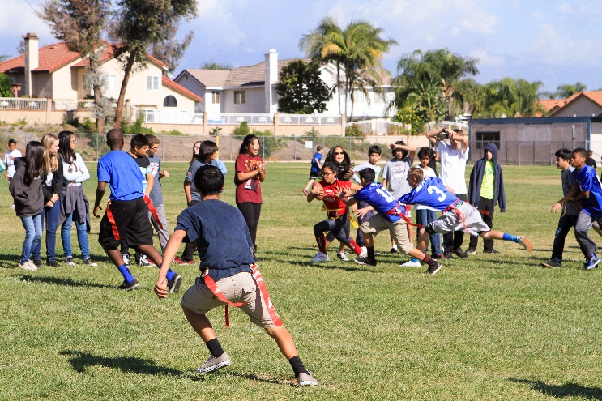
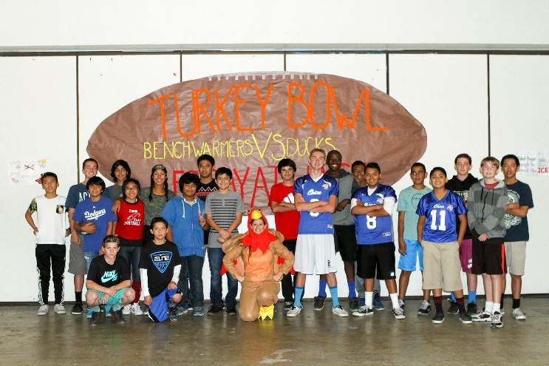
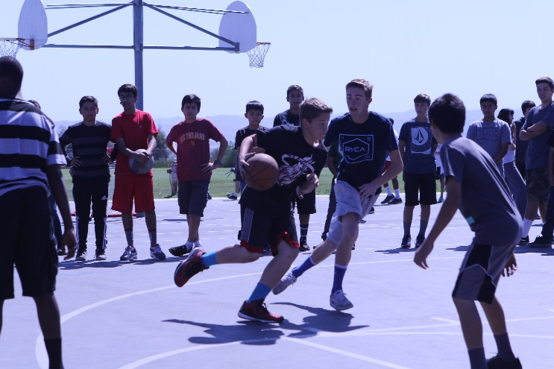
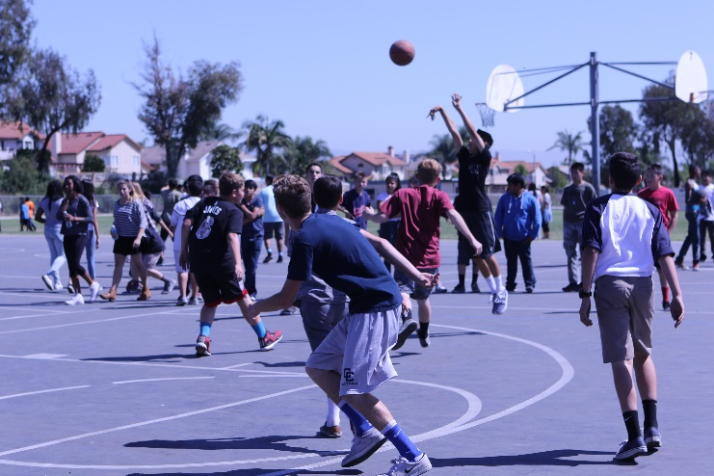
Intramural Sports

Slide 23
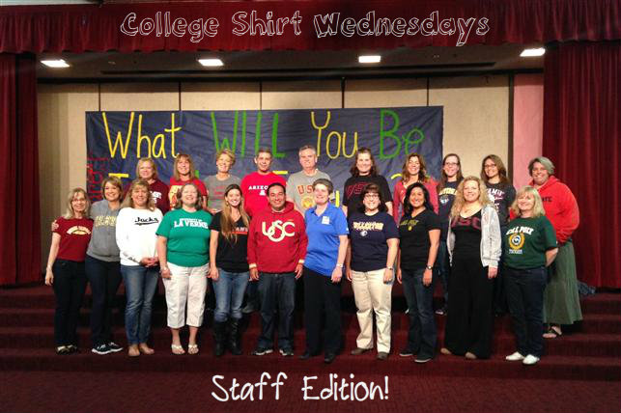
College Shirt Wednesdays

Slide 24
Behavior Expectations
Respect for oneself, instructional time, others and property
Progressive Discipline
Opportunities to Learn / Improve Behavior
Student Handbook
http://www.chino.k12.ca.us/Page/772
Cell Phones/ Electronic Devices:
Off / Not visible during the instructional day
Only for instructional purposes (w/ teacher consent)

Slide 25
Attendance
Regular attendance is essential to school success.
Students are not allowed to participate in after-school activities if they have been absent on the same day.
A phone call or written note from a parent/guardian must be presented to the Attendance Clerk prior to readmission to classes.
The Canyon Hills’ office staff will attempt to contact a parent/guardian to confirm unexcused absences
A student is considered tardy when he/she is not in their seat when the class bell rings.
Students arriving after school has started must report to the Attendance Clerk.

Slide 26
Dress Code
Clothing which allows undergarments to be visually observed is not permitted
Bare midriffs are not permitted
Halter, tube, spaghetti straps, strapless tops are not permitted.
Tight/revealing clothing is not permitted.
Tank tops are not permitted unless covered
Skirts or shorts must be no shorter than 5” above the knee
Clothing shall be free of writing, pictures or any other insignia which are crude, vulgar, profane, or sexually suggestive, which bear drug, alcohol or tobacco company advertising, promotions and likenesses or which advocate racial, ethnic or religions prejudice.

Slide 27
Drop-off & Pick-up
Regular Day
7:15am - School gates open
7:15-7:30am - Students in quad
7:30-7:45am– Students in quad/blacktop/field/library
Late Start MONDAY schedule
7:15am – School gates open
7:15-8:15am – Quad (Study Hall)
8:30am - Recommended Drop-off
8:15-8:45am – Students in quad/blacktop/field/library

Slide 28
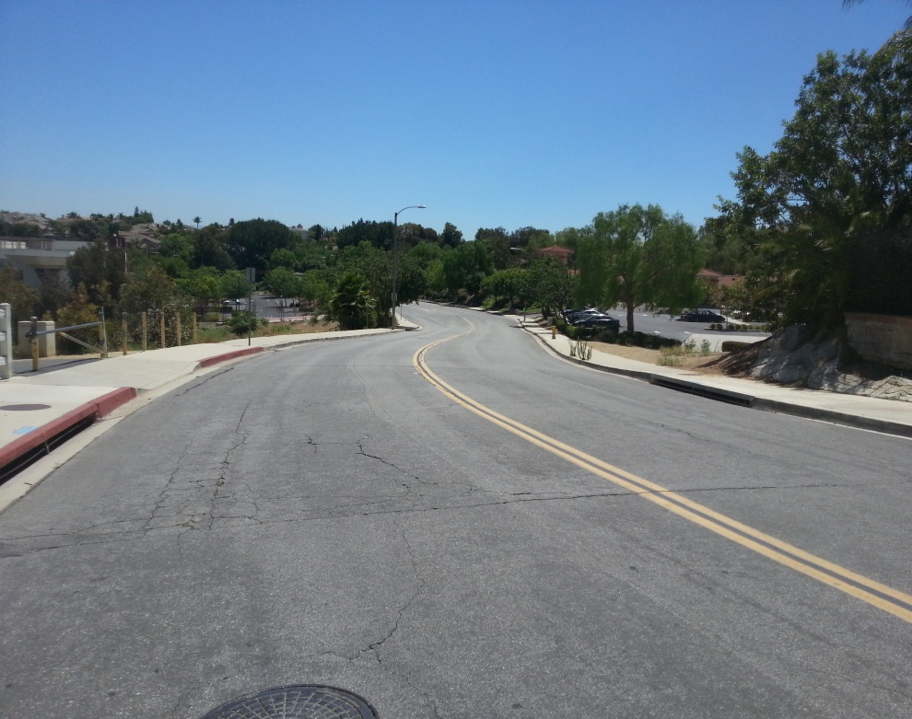
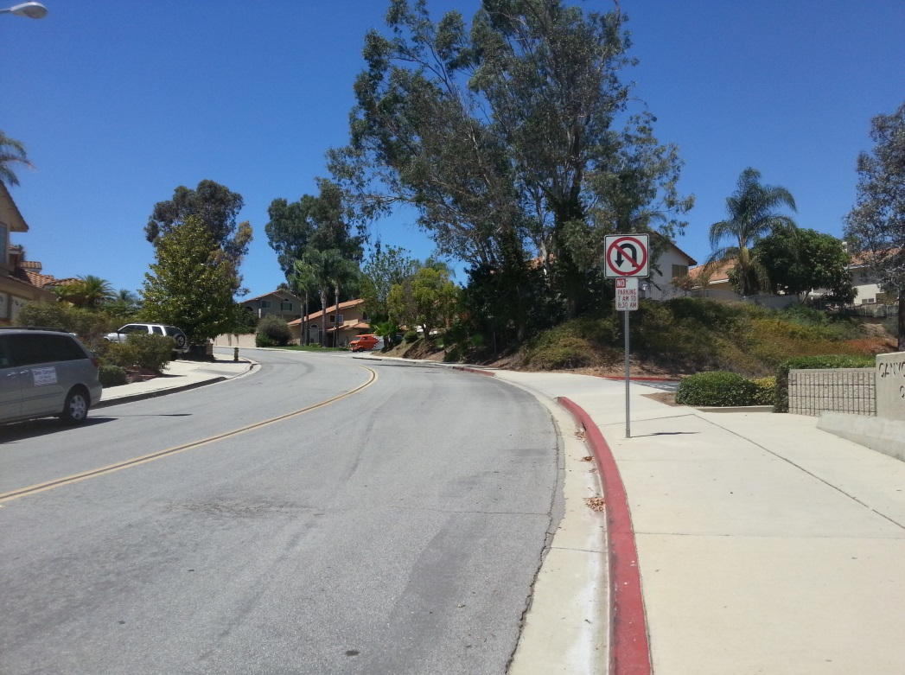
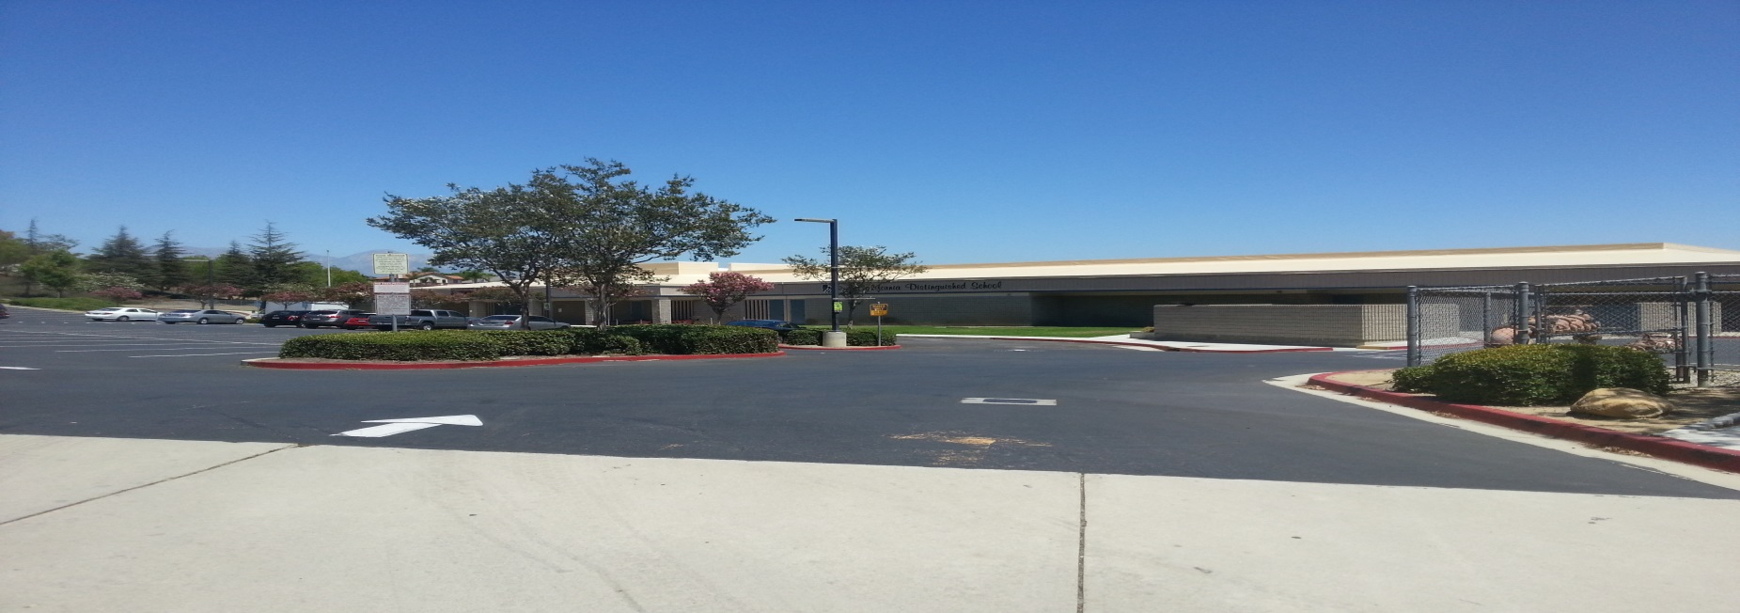

Slide 30
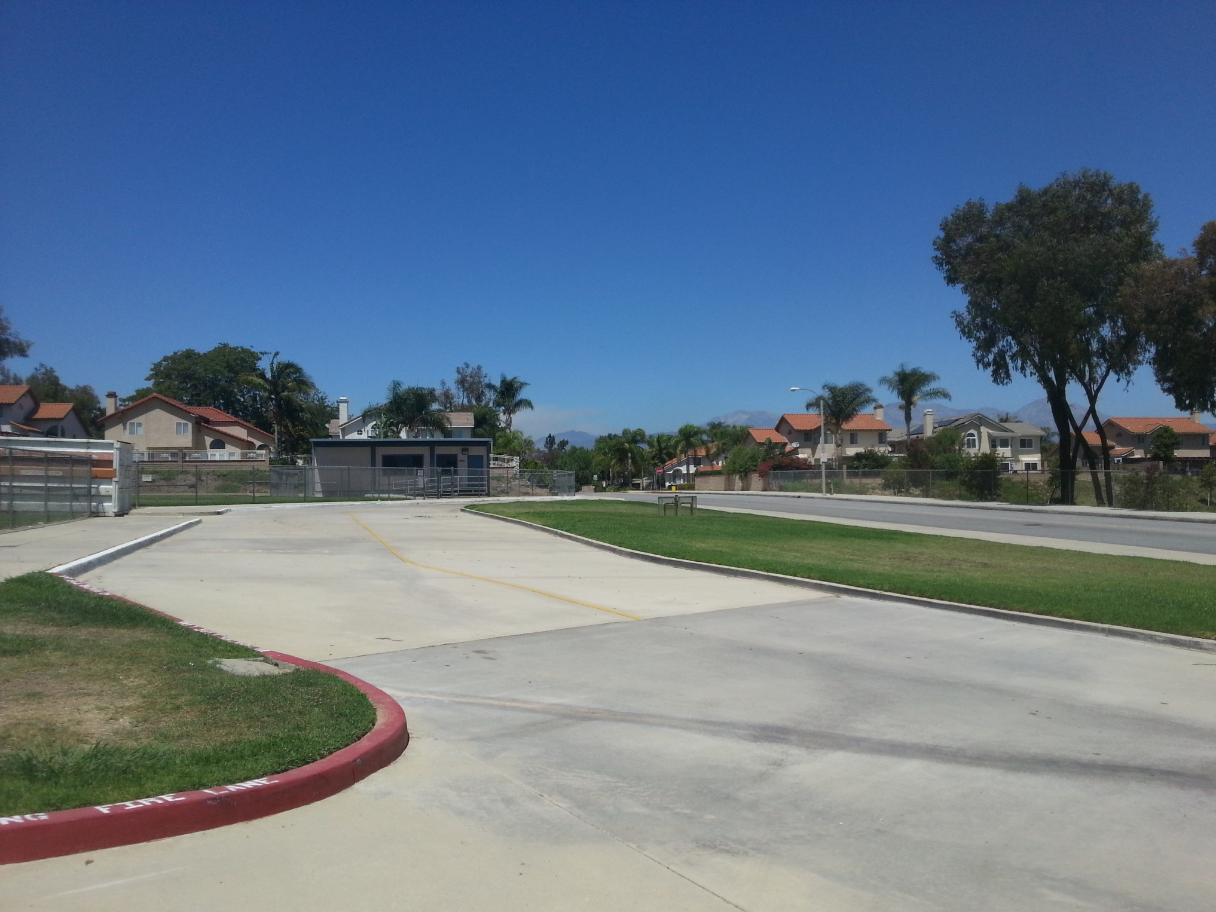

Slide 31
School Hours
REGULAR SCHEDULE – TUESDAY THROUGH FRIDAY
7:55 TO 1:58
LATE START - FIRST DAY OF THE WEEK (USUALLY MONDAY)
8:50 TO 1:56
MINIMUM DAY
7:55 TO 12:31

Slide 32
Rotating Schedule

Slide 33
Social & Emotional Well-being
Positive School Climate
School Connectedness
Creating the World’s Greatest Junior High School

Slide 34
Our Renaissance Program promotes and celebrates Academic Success with…

Slide 35
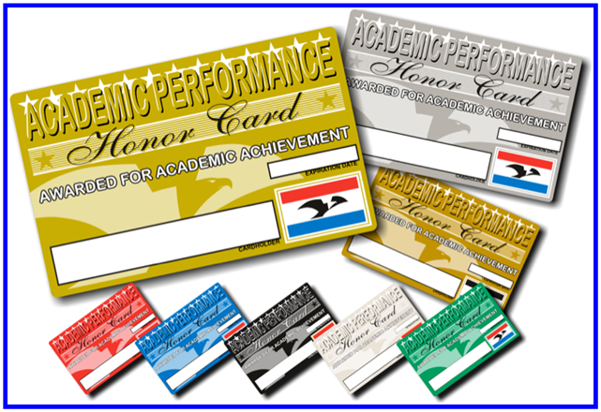
GPA Reward Levels
Gold 4.0
Silver 3.99 - 3.5
Bronze 3.49 - 3.0
Maroon 2.99 - 2.5
Coyote 2.49 -2.0
High 5 - Raise GPA .5 or higher

Slide 36
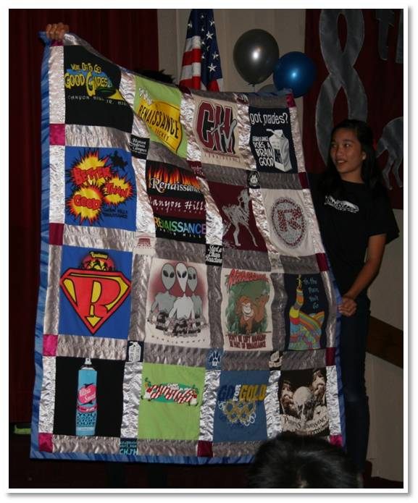
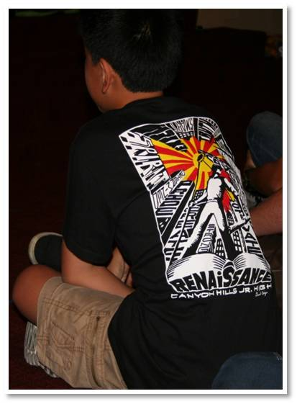
Annual Themed T- shirts

Slide 37
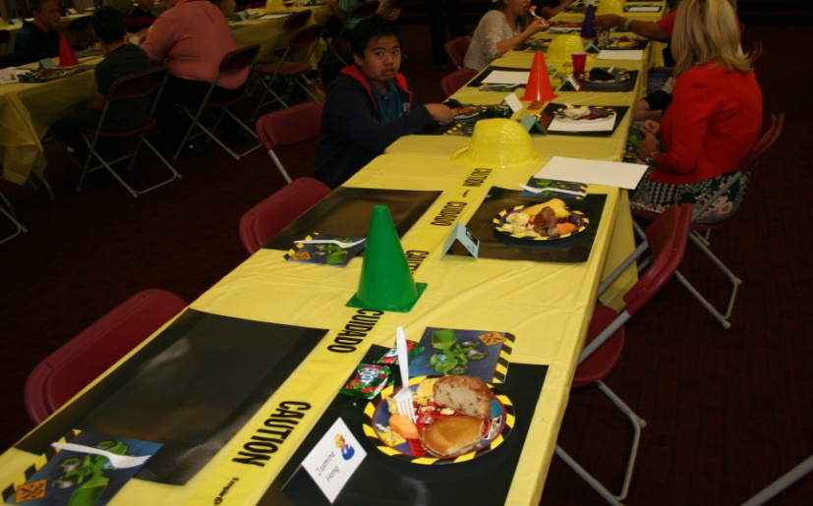
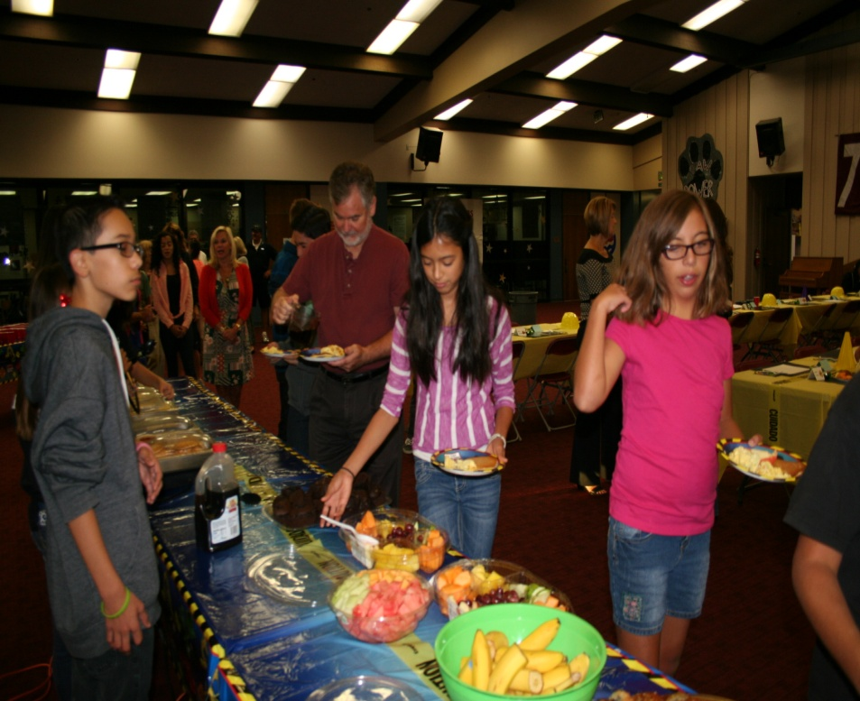
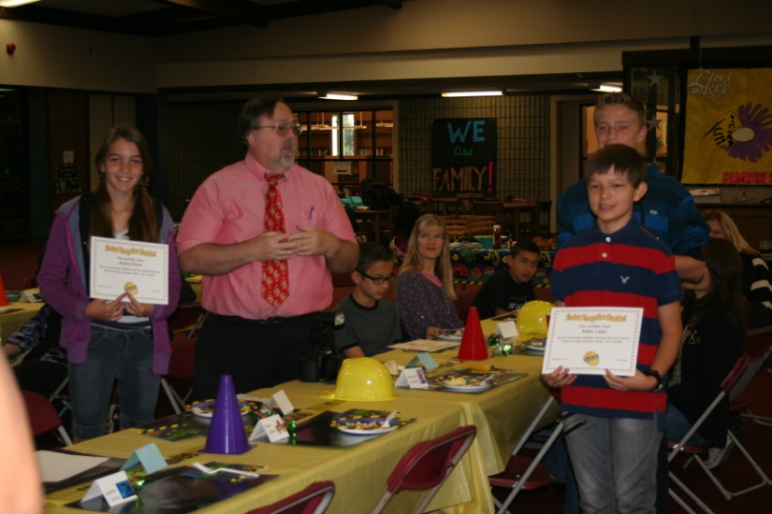
Student Recognition Breakfasts!

Slide 38
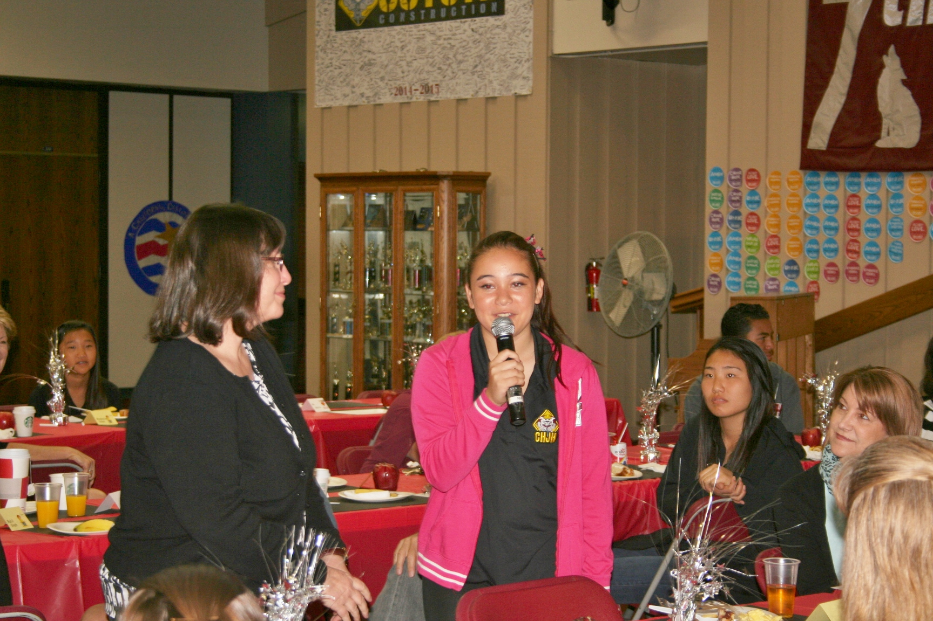
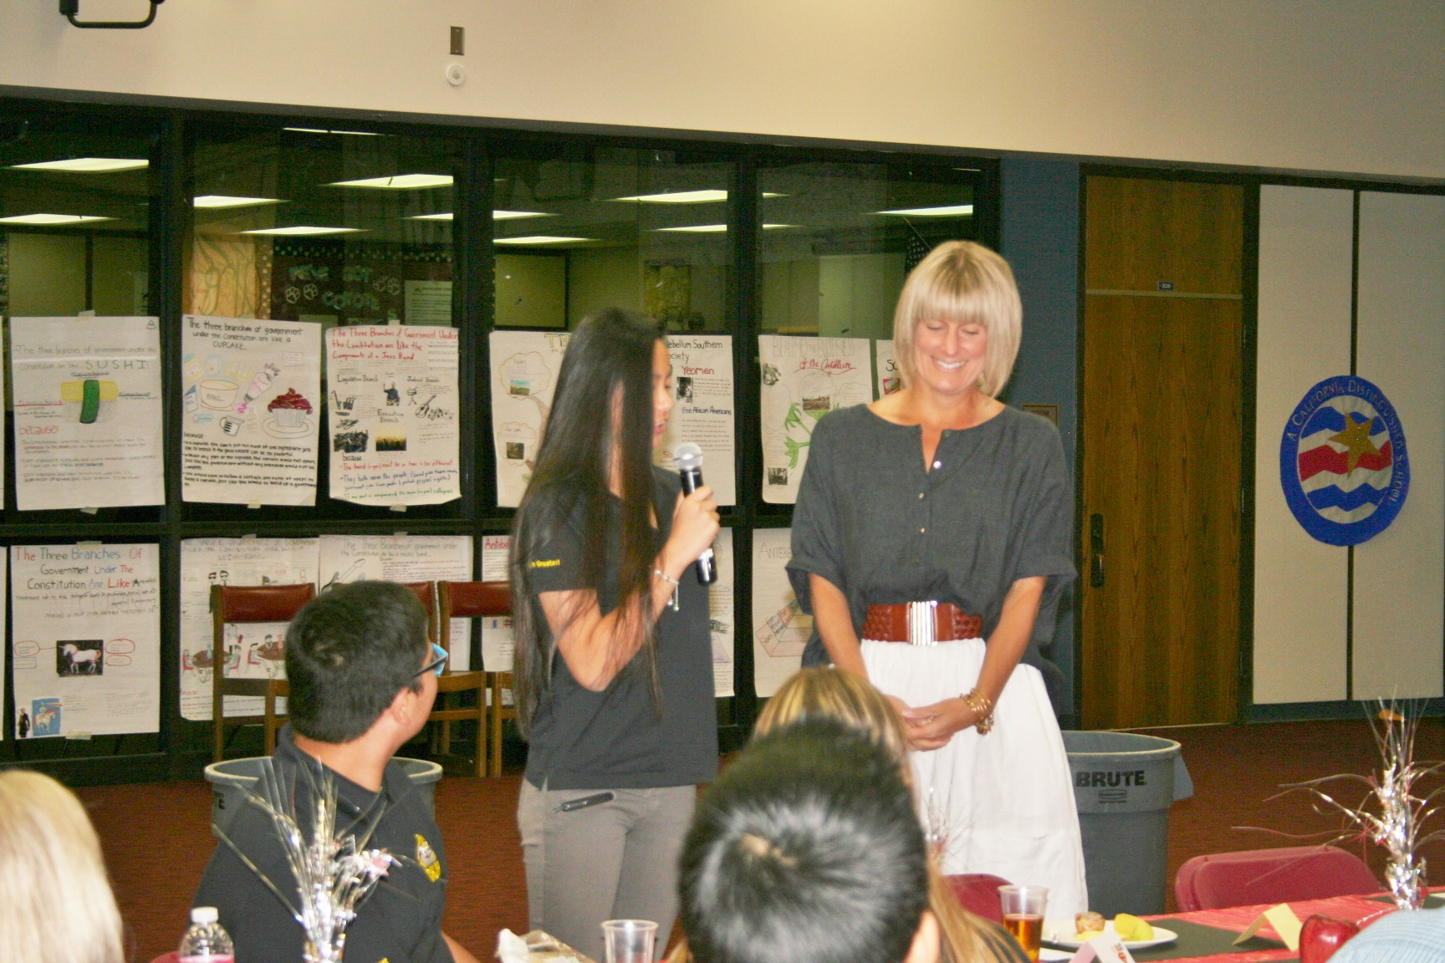
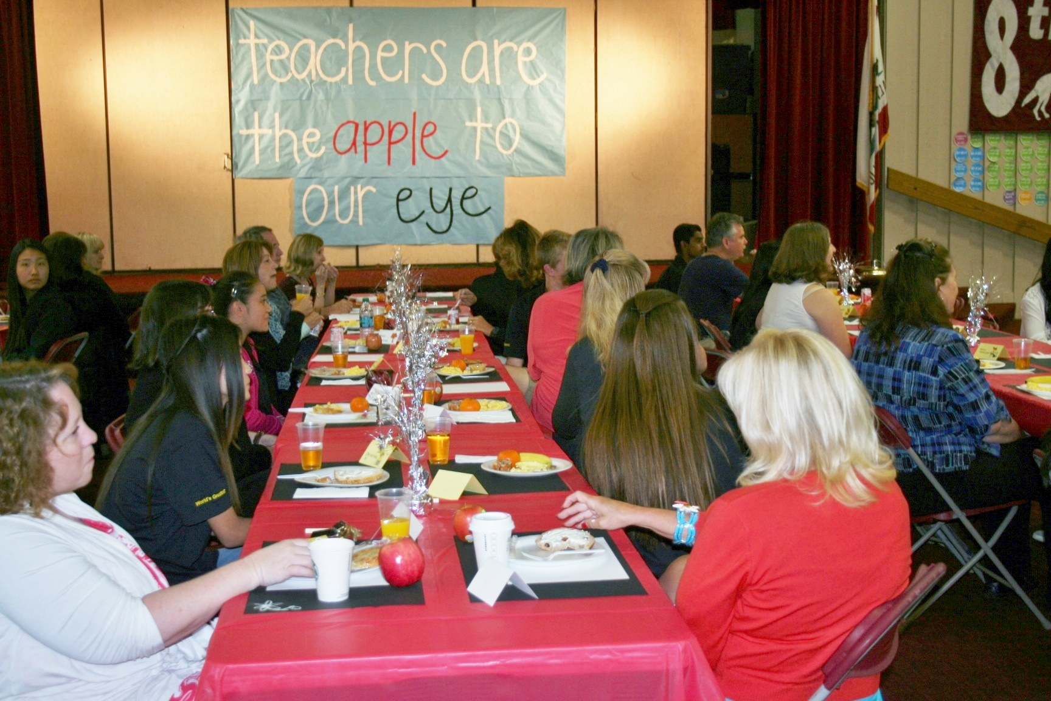
Teacher Recognition breakfast

Slide 39
Breakfast with a Staff Member

Slide 40
and lots of Smiles.

Slide 41
We produce three
Renaissance Rallies each year.
This past year our themes were:
Disneyland
Grease
Coyote Choice Awards

Slide 42
Disneyland

Slide 43
Disneyland

Slide 44
GREASE

Slide 45
Rallies from past years

Slide 46
Rallies from past years

Slide 47
We also have Motivational Speakers
like Keith Hawkins and Tyler Durman

Slide 48
And Inspirational Assemblies
like Rachel’s Challenge

Slide 49
Canyon Hills also has
lots of Clubs and Activities too.
We encourage students
to get involved!

Slide 50
Tennis Club
Anime Club

Slide 51
Christian Club
Color Guard

Slide 52
Culinary Cooking
Club
Debate Club

Slide 53
Drumline
FBLA

Slide 54
Indian Culture
Club
Go Green or Go
Home Club

Slide 55
Safe School
Ambassadors
Sports Zone

Slide 56
Ed ACTS
Global Club
Robotics Club

Slide 57
Reading/Writing Club
Art Club
Christian Club
Dance Club

Slide 58
Other Kinds of Activities We Do at Canyon Hills Include:

Slide 59
Donut, Pizza and Ice Cream Reward Parties

Slide 60
Fundraiser FuN!

Slide 61
Spelling Bee
Geography Bee

Slide 62
Math Meets

Slide 63
Career Day

Slide 64
Dances

Slide 65
Red Ribbon Week

Slide 66
Holiday Grams

Slide 67
Lunchtime Activities

Slide 68
Lunchtime Activities

Slide 69
Lunchtime Activities

Slide 70
Lunchtime Activities

Slide 71
Spirit Week

Slide 72
Spirit Week

Slide 73
Twin Day

Slide 74
Twin Day

Slide 75
Superhero Day

Slide 76
Staff Superheroes

Slide 77
Sweet Heart to Sweet Heart

Slide 78
It all makes for
a very busy day with dreams
for an even
better tomorrow…

Slide 79
First Day of school
Late Start Day (8:46am)
Memorize id # for lunch (multiple locations)

Slide 80
Thank you for attending this evening.​
​
We’re looking forward to a great year!

